Slide 1
MLOps
Università di Modena e Reggio Emilia
Prof. Nicola Bicocchi (nicola.bicocchi@unimore.it)

Slide 2
Motivation for MLOps

Slide 3
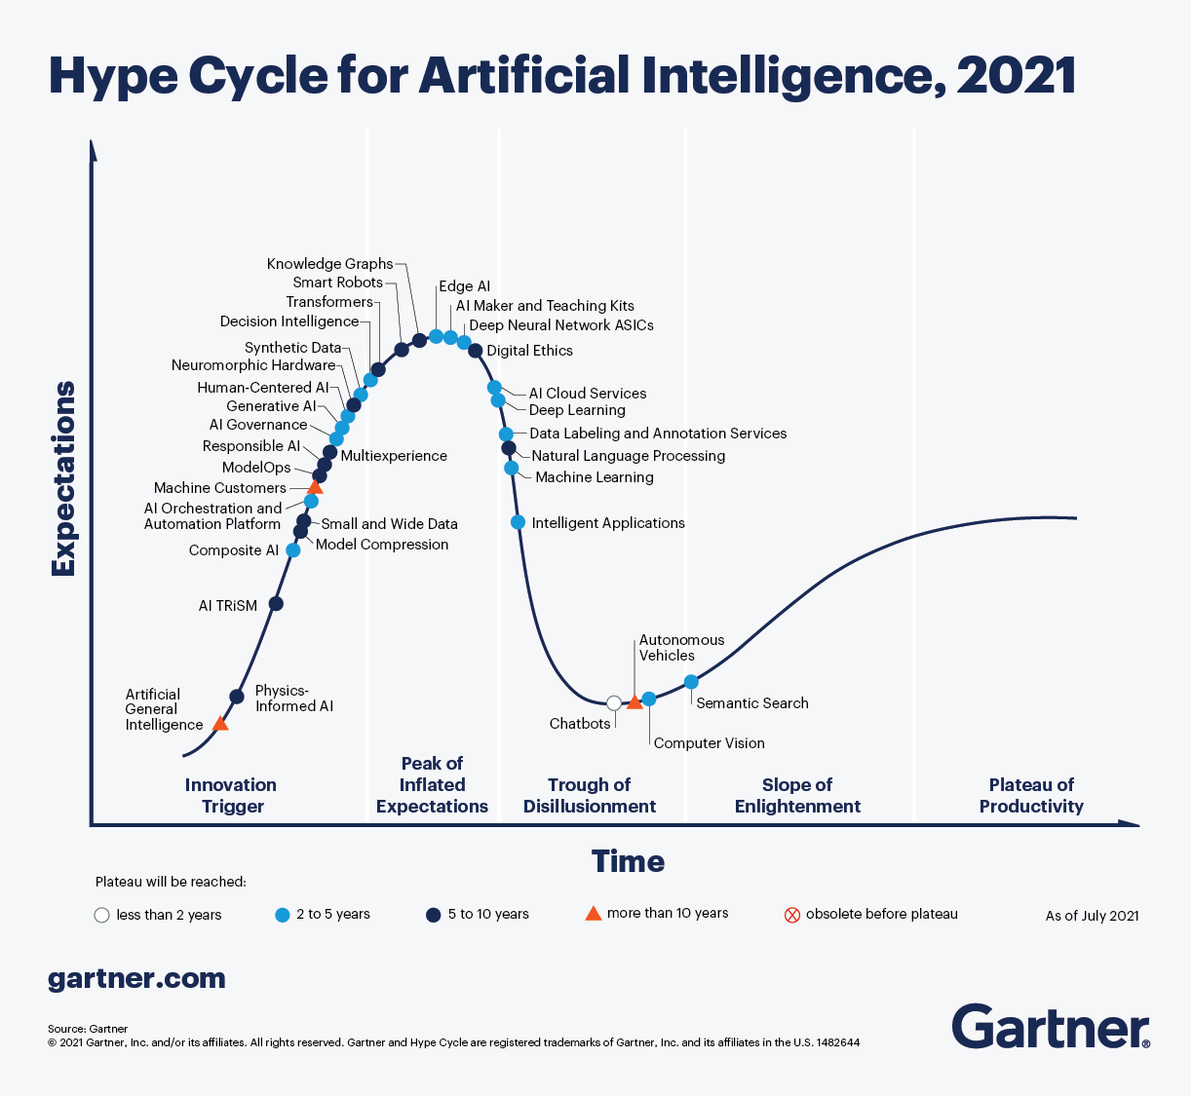

MLOps

Slide 4
State of Enterprise ML/AI
According to a report by Algorithmia “2020 State of Enterprise Machine Learning”, many companies haven’t figured out how to achieve their ML/AI goals.
About 20 percent of companies that use machine learning have successfully deployed an ML model into production.
About 20 percent of companies stated that it takes from three months to a year to deploy a model.
According to the report “The main challenges people face when developing ML capabilities are scale, version control, model reproducibility, and aligning stakeholders”.

Slide 5
State of Enterprise ML/AI
“One magical aspect of software is that it just keeps working. If you code a calculator app, it will still correctly add and multiply numbers a month, a year, or 10 years later. The fact that the marginal cost of software approaches zero has been a bedrock of the software industry’s business model since the 1980s.
This is no longer the case when you are deploying machine learning (ML) models. Making this faulty assumption is the most common mistake of companies taking their first artificial intelligence (AI) products to market. The moment you put a model in production, it starts degrading.”
Forbes - Why Machine Learning Models Crash And Burn In Production
“…developing and deploying ML systems is relatively fast and cheap, but maintaining them over time is difficult and expensive.”
D. Sculley et al., “Hidden Technical Debt in Machine Learning Systems, NIPS 2015
“The hardest part of machine learning today is deploying and maintaining accurate models, as it requires constant access to new data to update them and improve their accuracy.”
Chris Pouliot, Head of Data Science, NIO

Slide 6

State of Enterprise ML/AI

Slide 7
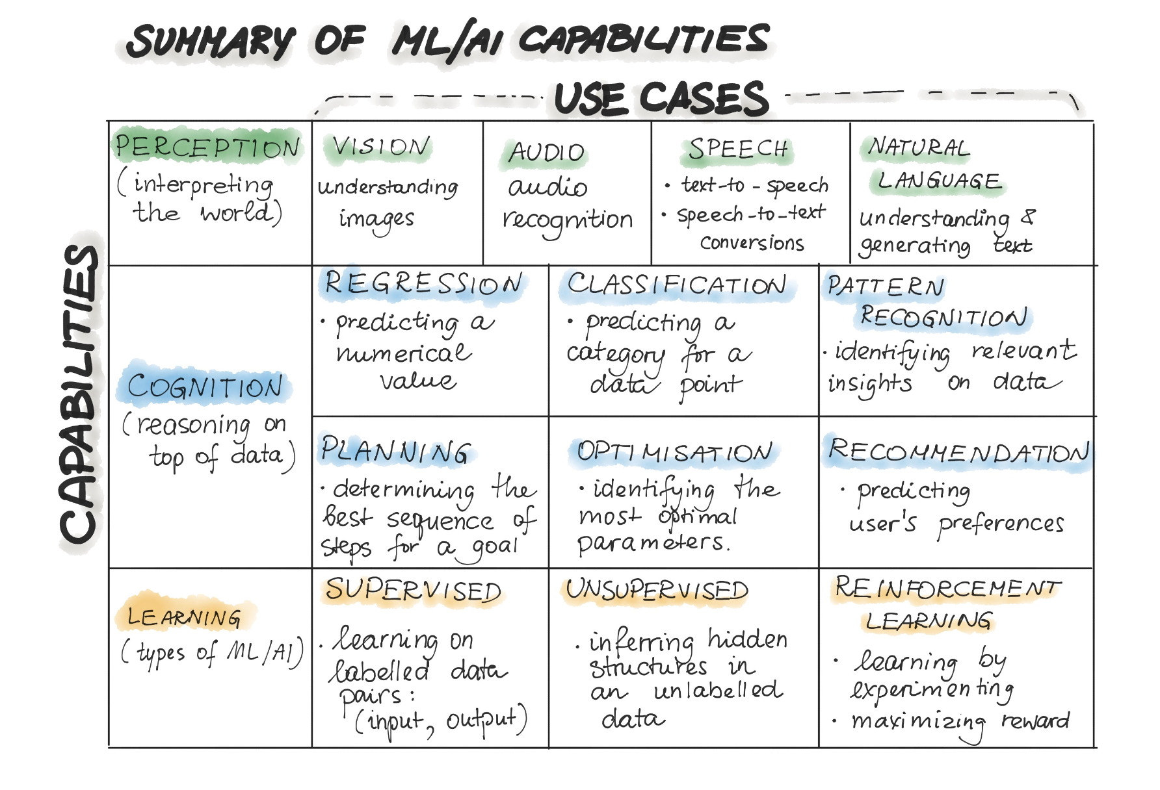
ML/AI Capabilities

Slide 8
Data and Code are behind a model
The reason for the previously described deployment gap is that the development of the machine learning-based applications is fundamentally different from the development of the traditional software.
Traditional software codifies actions as explicit rules.
ML does not codify explicitly. Instead, rules are indirectly set by capturing patterns from data. This makes ML more suitable for a more focused type of problem that can be treated numerically. For example, predicting salary from experience, education, location etc.

Slide 9
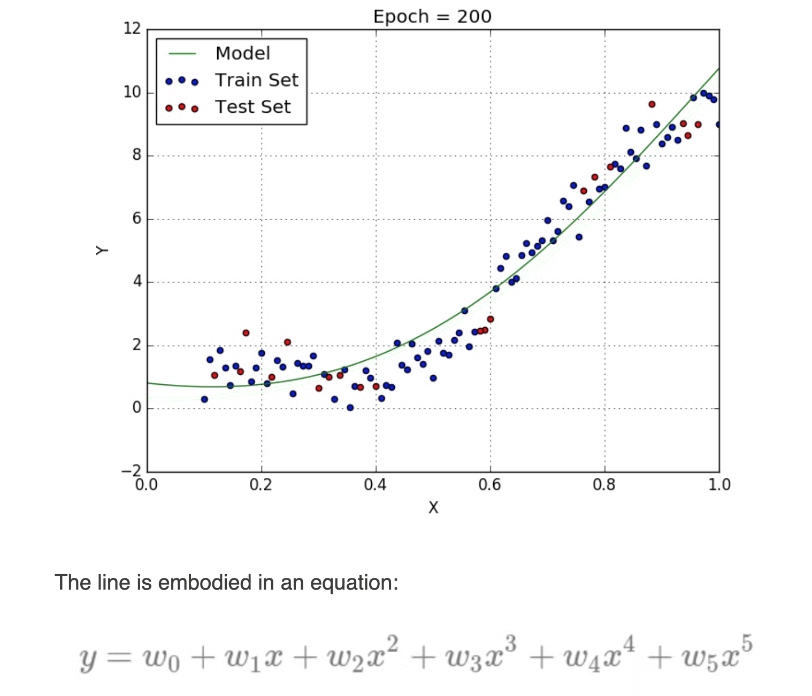

Data and Code are behind a model
The complete development pipeline includes three change levels: Data, Model, and Code.
In machine learning-based systems, the trigger for a build (or any other automated activity) might be the combination of a code change, data change, or model change. (see Technical Debt paper)

Slide 10
What can happen?
After serving the model to the end-users, we might recognize that the assumptions we made for training the model are wrong, so we have to change our model.
We might go back in the process and either collect more data, or collect different data and re-label training data. This should trigger the re-training of the ML Model.
After deploying the ML model into a software system, the model might start to decay and behave abnormally, so we would need new data to re-train our ML model.
Sometimes the business objective might change while project development and we decide to change the machine learning algorithm to train the model.
When transferring ML models to new business customers, these models, which have been pre-trained on different user demographics, might not work correctly according to quality metrics

Slide 11
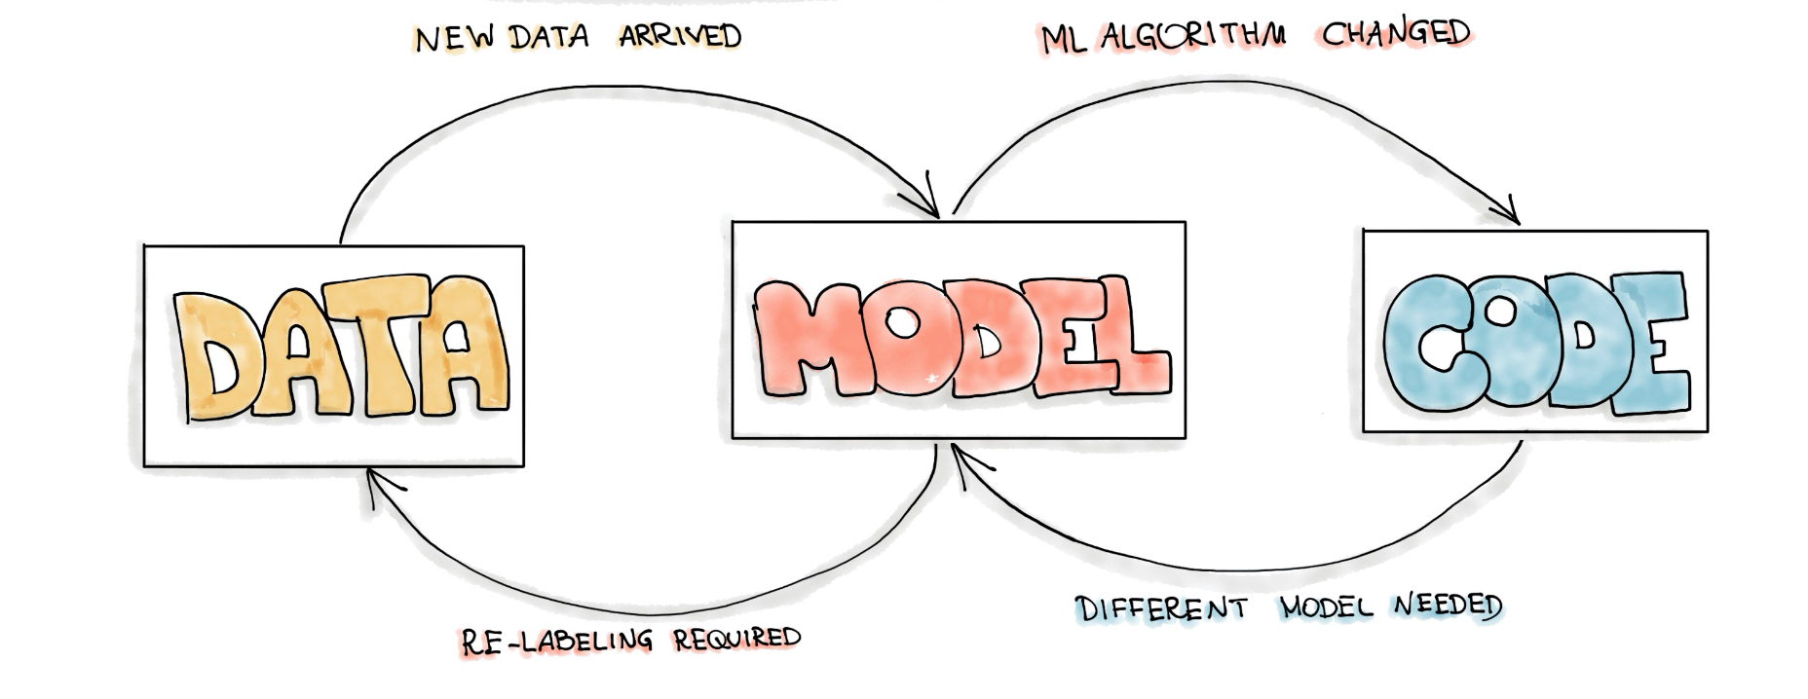
Changing Anything Changes Everything (CACE)

Slide 12
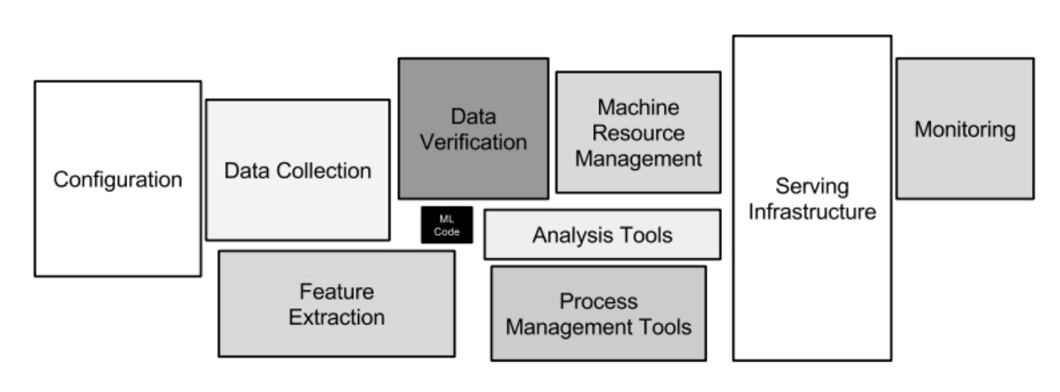
MLOps

Slide 13
AutoML
https://www.datarobot.com/

Slide 14
MLOps
“The extension of the DevOps methodology to include Machine Learning and Data Science assets as first-class citizens within the DevOps ecology” (https://github.com/cdfoundation/sig-mlops)
“The use of scientific principles, tools, and techniques of machine learning and traditional software engineering to design and build complex computing systems. Machine Learning Engineering encompasses all stages from data collection, to model building, to make the model available for use by the product or the consumers”

Slide 15
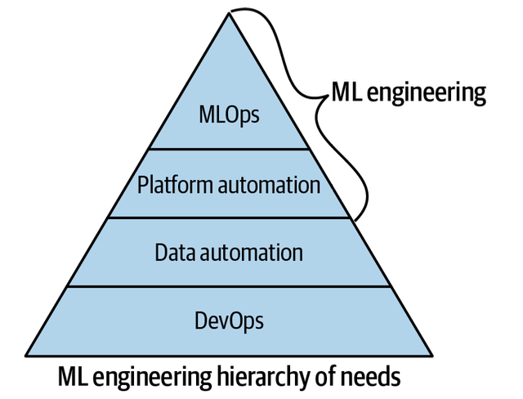
MLOps
MLOps shares a lineage with DevOps in that DevOps philosophically demands automation.
A common expression is if it is not automated, it’s broken.
Similarly, with MLOps, there must not be components of the system that have humans as the levers of the machine.
Think of MLOps as the process of automating machine learning using DevOps methodologies.

Slide 16
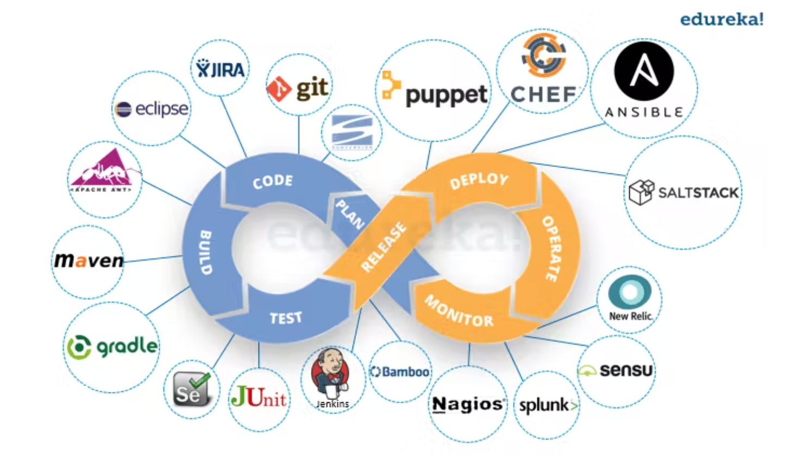
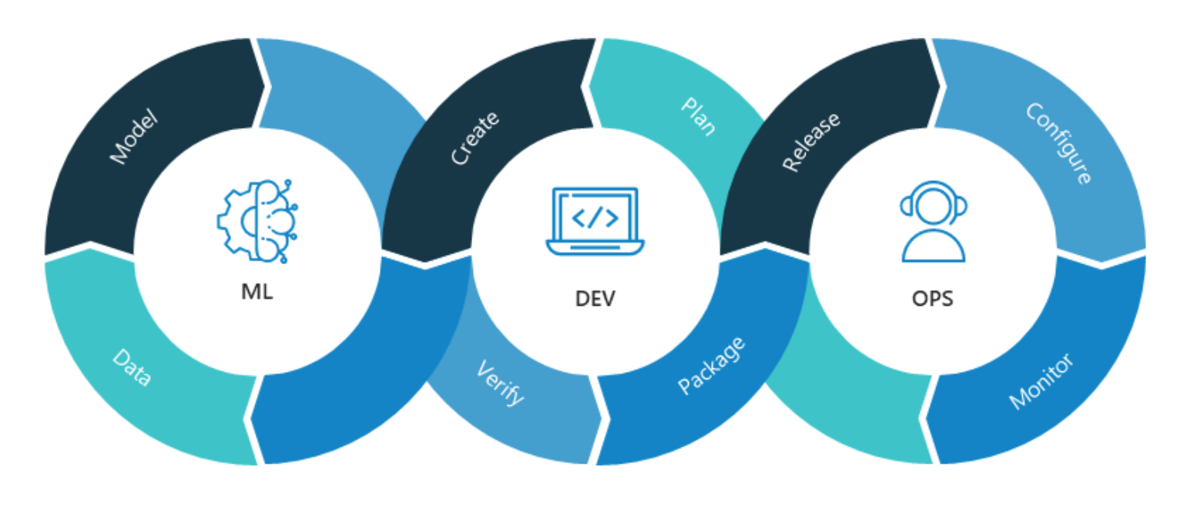
MLOps and DevOps

Slide 17
MLOps and DevOps
MLOps and DevOps share:
Automation
Collaboration and increased communication between teams
Continuous integration
Continuous delivery
Data-driven approach, focused on incremental progress (Kaizen)
MLOps and DevOps DO NOT share:
The complexity of the environment, including the fact that machine learning models are made up of both code and data (changing even faster than code)

Slide 18
MLOps and DevOps (Differences)
MLOps is much more experimental in nature. Data Scientists and ML/DL engineers have to tweak various features – hyperparameters, parameters, and models – while also keeping track of and managing the data and the code base for reproducible results.
Hybrid team composition: the team needed to build and deploy models in production won’t be composed of software engineers only.
Testing: testing an ML system involves model validation, model training, and so on – in addition to the conventional code tests, such as unit testing and integration testing.
Automated Deployment: you can’t just deploy an offline-trained ML model as a prediction service. You’ll need a multi-step pipeline to automatically retrain and deploy a model.

Slide 19
MLOps and DevOps (Differences)
Production degradation of the system due to evolving data profiles or simply Training-Serving Skew: ML models in production can have reduced performance not only due to suboptimal coding but also due to constantly evolving data profiles.
A discrepancy between how you handle data in the training and serving pipelines.
A change in the data between when you train and when you serve.
Feedback loop – when you choose the wrong hypothesis (i.e. objective) to optimize, which makes you collect biased data for training your model. Then, without knowing, you collect newer data points using this flawed hypothesis, and it’s fed back in to retrain/fine-tune future versions of the model, making the model even more biased, and the snowball keeps growing.
Monitoring: models in production need to be monitored. Similarly, the summary statistics of data that built the model need to be monitored so that you can refresh the model when needed. These statistics can and will change over time, you need notifications or a roll-back process when values deviate from your expectations.

Slide 20
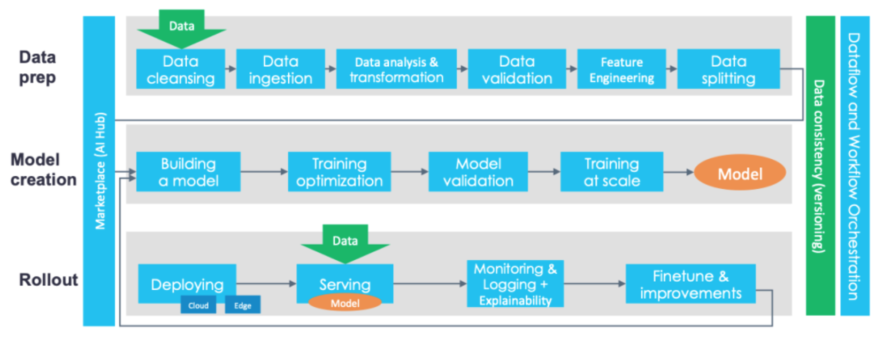
MLOps and DevOps (Differences)
Continuous Integration (CI) is no longer only about testing code, but also testing data, data schemas, and models.
Continuous Deployment (CD) is no longer about a single software package or service, but a system (an ML training pipeline) that should automatically deploy another service (model prediction service) or roll back changes from a model.
Continuous Testing (CT) is a new property that’s concerned with automatically retraining and serving the models.

Slide 21
MLOps
MLOps, like DevOps, emerges from the understanding that separating the ML model development from the process that delivers it — ML operations — lowers quality, transparency, and agility of the whole intelligent software.
unify the release cycle for machine learning and software application release.
automated testing of machine learning artifacts (e.g. data validation, ML model testing, and ML model integration testing)
application of agile principles to machine learning projects.
supporting machine learning models and datasets to build these models as first-class citizens within CI/CD systems.
reduction of technical debt across machine learning models.
language-, framework-, platform-, and infrastructure-agnostic practice.

Slide 22
Other OPs
ModelOps is more general than MLOps, as it’s not only about machine learning models but any kind of model (e.g., rule-based models).
AIOps is another topic entirely and refers to the process of solving operational challenges through the use of artificial intelligence (i.e., AI for DevOps). For example, predictive maintenance alerting DevOps teams to possible problems before they arise.
DataOps is a set of practices, processes and technologies that combines data with automation and methods from agile software engineering to improve quality, speed, and collaboration and promote a culture of continuous improvement in the area of data analytics.

Slide 23
ML/AI-related risks

Slide 24
ML/AI Risk sources
Business organization
Runtime environment
Reality changes
Business changes
Scale and Automation

Slide 25
Risk sources (business organization)
The ML life cycle involves people from the business, data science, IT teams. None of these groups use the same tools or even share the same skills to serve as a baseline of communication. Most data scientists are specialized in model building and assessment, and they are not necessarily experts in writing applications.
Leads to: bugs, implementations not matching business questions, inconsistencies between testing and running environments
Requires: more specialized division of labour

Slide 26
Risk sources (runtime environment)
Learning performance is often very sensitive to the production environment it is running in. Models are often built on a pile of open source software (e.g., libraries, like scikit-learn, Python, or Linux). Production and development versions must match.
Leads to: inconsistencies in model behaviour (hard to find and debug)
Requires: CD/CI, automated tests, containerized environments

Slide 27
Risk sources (reality changes)
Reality (and subsequently data) always changes. …
Leads to: model drift
Requires: constant monitoring for understand whether retrained models are better than the previous versions and ensuring (at defined periods—daily, monthly, etc.) that model performance is not degrading in production. Also requires data versioning.

Slide 28
Risk sources (business changes)
Business always changes. Results need to be continually relayed back to the business to ensure that the reality of the model in production aligns with expectations and, critically, addresses the original problem or meets the original goal.
Leads to: new business goals, new data, new models, new training processes
Requires: widespread automation

Slide 29
Scale and automation
Until models were managed at a small scale there was less interest in understanding them and their dependencies.
With scale and decision automation (an increasing prevalence of decision-making without human intervention)
models become more critical
managing risk becomes more important at the top level (management is responsible for models).
Introducing automation vis-à-vis machine learning models shifts accountability from the bottom of the hierarchy to the top.
Decisions that were perhaps previously made by individual contributors who operated within a margin of guidelines (for example, what the price of a given product should be) are now being made by a model. The person responsible for the automated decisions is likely a data team manager or even executive.

Slide 30
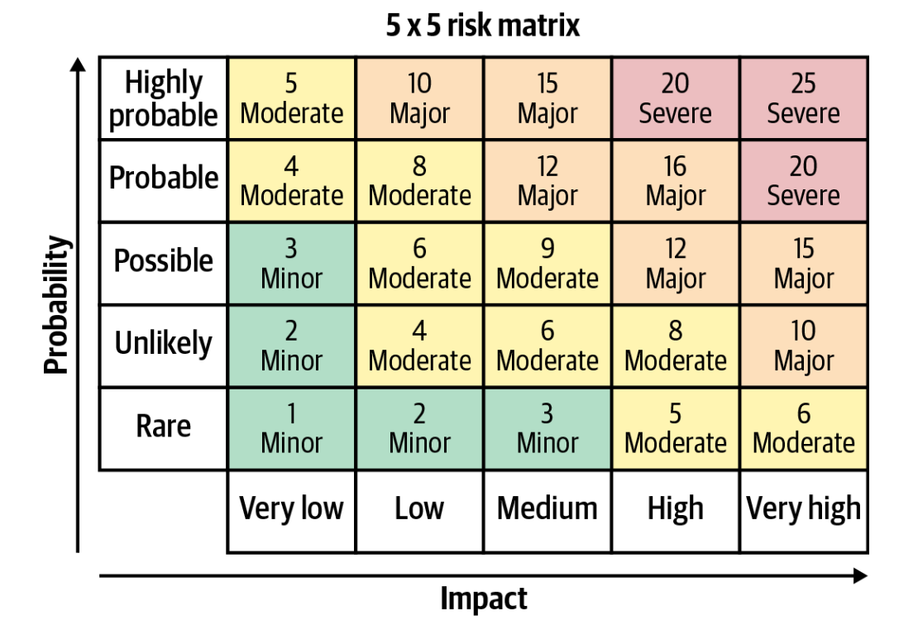
Risk assessment
In machine learning models, risks vary widely. For example, the stakes are much lower for a recommendation engine used once a month to decide which marketing offer to send a customer than for a travel site whose pricing and revenue depend on a machine learning model.
The risk that the model is unavailable for a given period of time
The risk that the model returns a bad prediction for a given sample
The risk that the model accuracy or fairness decreases over time
The risk that the skills necessary to maintain the model (i.e., data science talent) are lost

Slide 31
Responsible AI
Intentionality: models are designed and behave in ways aligned with their purpose. This includes the assurance that data used for AI projects comes from compliant and unbiased sources plus a collaborative approach to AI projects that ensures multiple checks and balances on potential model bias.
Explainability: the results of AI systems should be explainable by humans (ideally, not just the humans who created the system).
Accountability: overall view of which teams are using what data, how, and in which models. It also includes the need for trust that data is reliable and being collected in accordance with regulations as well as a centralized understanding of which models are used for what business processes.
Traceability: if something goes wrong, the ability to find where in the pipeline it happened.

Slide 32
ML/AI Organizational Roles

Slide 33
ML/AI Organizational Roles
MLOps involves a diverse group of experts across the organization.
Each person from the subject matter expert to the most technical machine learning architect plays a critical part in the maintenance of ML models in production.
This is ultimately important not only to ensure the best possible results from ML models (good results generally lead to more trust in ML-based systems as well as an increased budget to build more), but also to protect the business from risk.

Slide 34
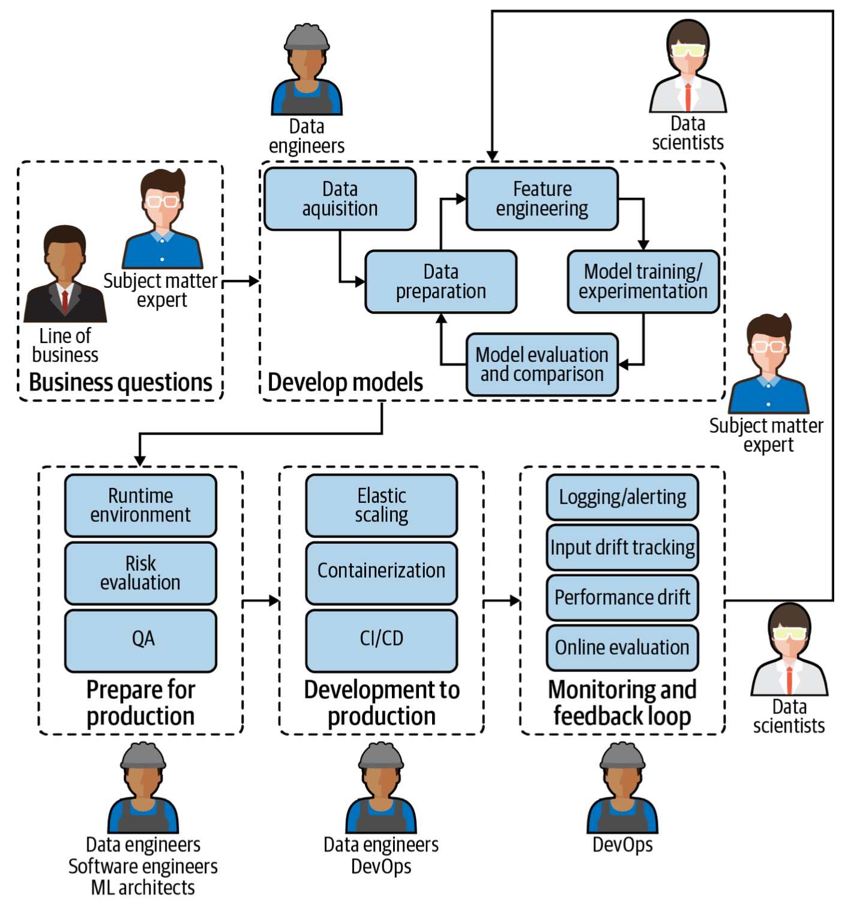
Subject matter experts
Provide business questions, goals, or KPIs (Key Performance Indicator) around which ML models should be framed.
Continually evaluate and ensure that model performance aligns with the initial need.
MLOps requirements
Easy way to understand deployed model performance in business terms.
Mechanism or feedback loop for flagging model results that don’t align with business expectations.

Slide 35
Data scientists
Build models that address the needs of subject matter experts.
Deliver operationalizable models so that they can be properly used in the production environment.
Assess model quality (of both original and tests) in tandem with subject matter experts to ensure they answer business questions.
MLOps requirements
Automated model packaging and delivery for quick and easy (yet safe) deployment to production.
Ability to develop tests to determine the quality of deployed models and to make continual improvements.
Visibility into the performance of all deployed models (including side-by-side for tests) from one central location.

Slide 36
Data engineers
Integrate ML models in the company’s applications and systems.
Ensure that ML models work seamlessly with other non-machine-learning-based applications.
MLOps requirements
Versioning and automatic tests.
The ability to work in parallel on the same application.

Slide 37
Software engineers
Optimize the retrieval and use of data to power ML models.
MLOps requirements
Visibility into performance of all deployed models.
Ability to see the full details of individual data pipelines to address underlying data plumbing issues.

Slide 38
ML architects
Ensure a scalable and flexible environment for ML model pipelines, from design to development and monitoring.
Introduce new technologies when appropriate that improve ML model performance in production.
MLOps requirements
A high-level overview of models and their resources consumed.
Ability to drill down into data pipelines to assess and adjust infrastructure needs.

Slide 39
Model risk managers/auditors
Minimize overall risk to the company as a result of ML models in production.
Ensure compliance with internal and external requirements before pushing ML models to production.
MLOps requirements
Robust, likely automated, reporting tools on all models (currently or ever in production), including data lineage.

Slide 40
DevOps
Conduct and build operational systems and test for security, performance, availability.
Continuous Integration/Continuous Delivery (CI/CD) pipeline management.
MLOps requirements
Seamless integration of MLOps into the larger DevOps strategy of the enterprise.
Seamless deployment pipeline.

Slide 41
Designing ML-powered Software

Slide 42
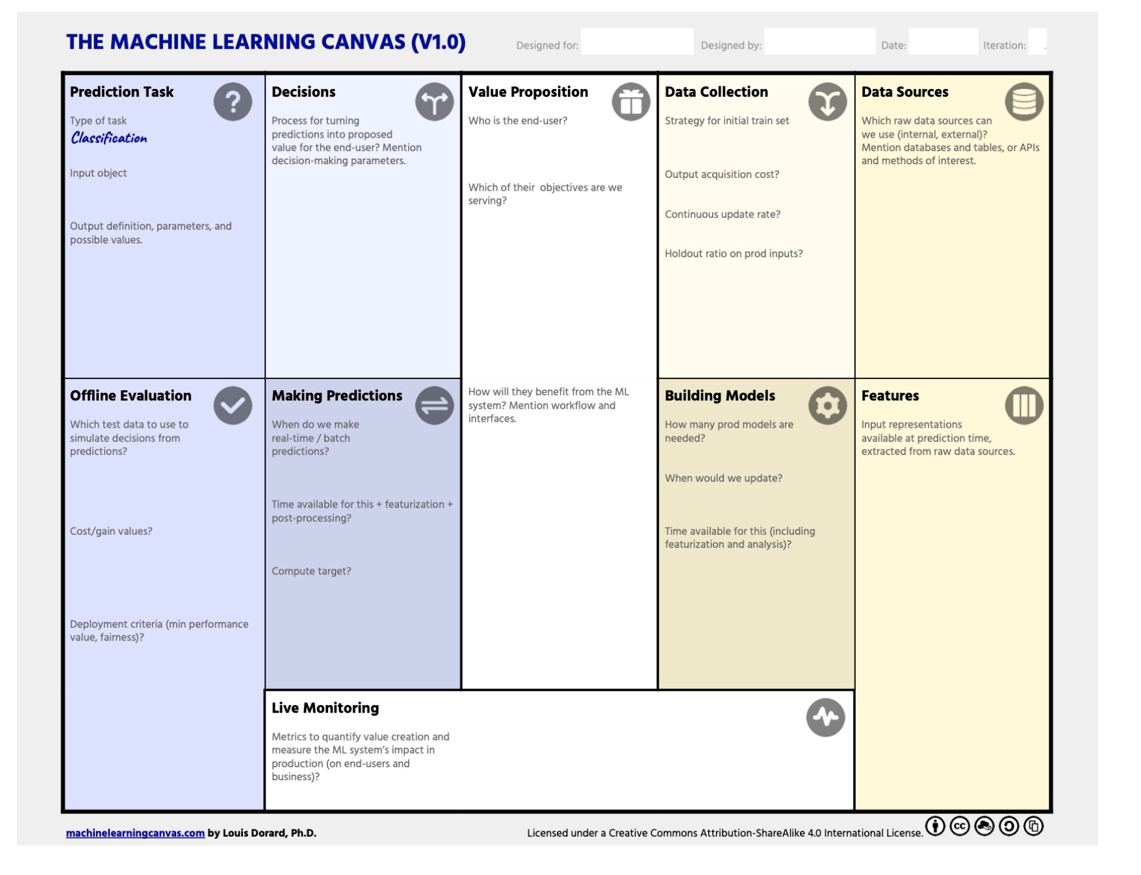
Machine Learning Canvas
The ML Canvas lets you lay down your vision for your ML system and communicate it with your team.
Connect what ML can do to your organization’s objectives, and towards assessing feasibility.
Identify key constraints of ML system, which have an impact on the technology to choose.
Describe how your ML system will turn predictions into value for end-users, which data it will learn from, and how to make sure it will work as intended.
Anticipate costs, identify bottlenecks, specify requirements, and create a roadmap.
https://www.ownml.co/machine-learning-canvas

Slide 43
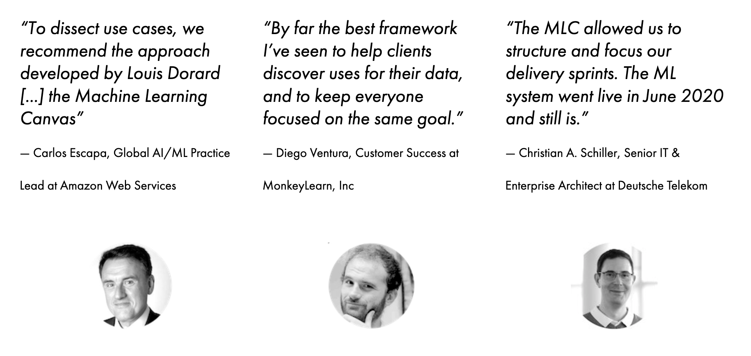
Machine Learning Canvas

Slide 44
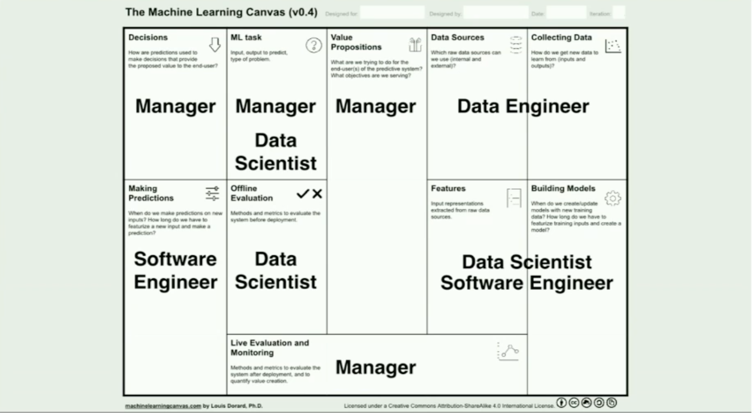
Machine Learning Canvas

Slide 45
Machine Learning Canvas
Value Proposition
This is the crucial blocks in the whole canvas. Here we should answer three important questions:
What is the problem? What objective are we serving? What are we trying to do for the end-user?
Why is it important?
Who is the end-user?

Slide 46
Machine Learning Canvas
Data Sources
In this block, we clarify all available and possible data sources to be used for the ML task.
Internal/external databases
Data marts, OLAP cubes, data warehouses, OLTP systems
Hadoop clusters
REST APIs to gather data
Static files, spreadsheets
Web scraping
The output of other (ML) systems
Open-source data sets

Slide 47
Machine Learning Canvas
Data Collection
Gathers information about new data that should be collected in order to re-train the ML model. Prevents the ML model decay phenomenon.
How do we label the new data?
How expensive is it to collect new data?
How expensive is it to process rich media like images, sound, or video?
Is there human in the loop for the manual cleaning and labelling of the incoming data?
Initial dataset (timeframe)?

Slide 48
Machine Learning Canvas
Prediction Task
After clarifying what data is available, we brainstorm what type of ML should be used. Here are some examples of questions that might clarify the ML Task:
Recommendation, regression, classification, clustering?
What is the input for a prediction task? (e.g. E-mail text)
What is the output of the prediction task? (e.g. spam)
What is the degree of complexity our ML Model could assume? (e.g. is our model a combination of other ML models? Do we employ ensemble learning?)
What are the complexity costs, such as training and inference time, for the above models?

Slide 49
Machine Learning Canvas
Decisions
How are prediction used to make decisions?
How does the end-user or the system interacts with the model predictions?
e.g. What happens if the user gets a list of product recommendations? What happens if the incoming e-mail is classified as “spam”?
Are there hidden costs in decision making, such as human in the loop?
Such information is required to later decide on how to deploy the ML model.

Slide 50
Machine Learning Canvas
Live Monitoring
After deployment, the ML model should be evaluated and here we would need to specify both model and business metrics, which should correlate. Generally, the metrics should follow the S.M.A.R.T methodology and be: Specific, Measurable, Achievable, Relevant, and Time-bound.
How do we track the system performance?
e.g. A/B Testing
How do we evaluate the value creation?
e.g users spent less time on the inbox.

Slide 51
Machine Learning Canvas
Features
As every ML algorithm requires input data in the form of features, we should clarify how should the input data be represented.
How do we extract features from raw sources?
Consider to include domain experts to specify what data aspects are most important for the particular ML task.

Slide 52
Machine Learning Canvas
Building Models
Regards updating the ML models, because different ML tasks require different frequencies of model re-training:
How often the model should be retrained?
e.g. hourly, weekly, or with every new data point.
What are the hidden costs for model re-training?
do we use cloud resources to perform such tasks?
what is the price policy of the cloud vendor?
how should we perform hardware cost estimation?
How long will it take to re-train the model?
How do we deal with the scaling issues of cloud operations as they can be more complex and costly?
Do we plan for change in the tech stack?
e.g. how can we deal with the tech stack evolution as new tools and development workflows are emerging in the modern AI?

Slide 53
Machine Learning Canvas
Offline Evaluation
Domain specific metrics that justify the deployment of the ML model. For example, simulated with the training and testing data, would the prediction of the model generate more revenue than the revenue created in the “traditional” way.
What technical evaluation metrics should be used?
Precision, Recall, F-1 measure.
Accuracy.
What is the meaning of model prediction errors such as false positives and false negatives?
How much test data do we need to be confident that the ML model performs well?

Slide 54
Machine Learning Canvas
Making Predictions
This block includes information about when we make a prediction on new inputs.
When should predictions be available?
New predictions are made each time when the user opens the app, such as recommendations.
New predictions are made on request.
New predictions are made on schedule.
Are predictions made on the fly for each data point or for a batch of the input data?
How computationally complex could the model inference get in the application?
Is there a human in the loop to support in making predictions?

Slide 55
Should we deploy AI/ML?
The deliverable in this stage is the completed Machine Learning Canvas. The effort to fill out this canvas might initiate an existential discussion regarding the real objective and hidden costs of the ML-software.
Such a discussion might result in a decision not to implement AI/ML at all. Possible reasons can be as follows:
The solution to our problem does not tolerate wrong predictions.
Implementing AI/ML would generate a low ROI.
The maintenance of the ML/AI project is not guaranteed or is too expensive

Slide 56
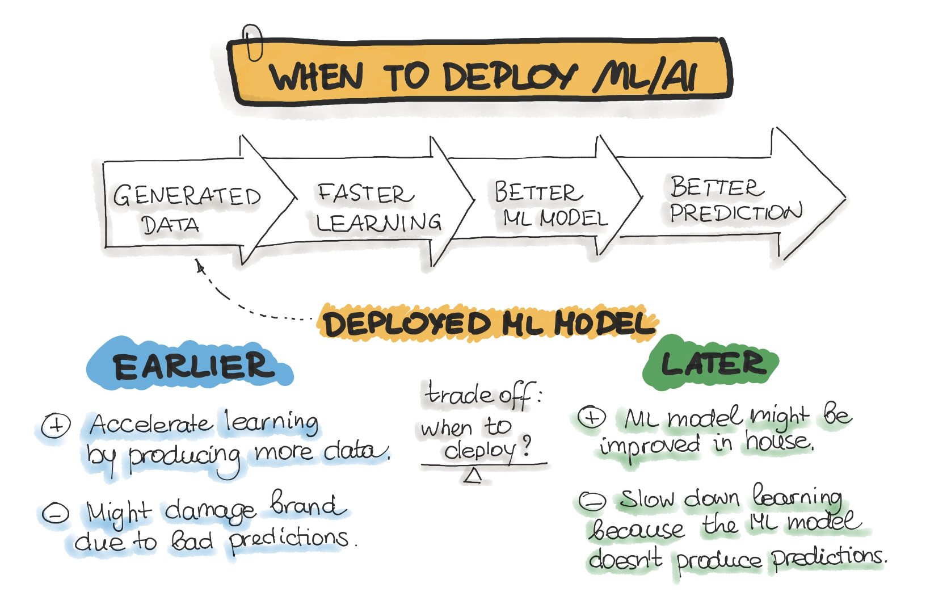
Should we deploy AI/ML now?

Slide 57
An Overview of the End-to-End Machine Learning Workflow

Slide 58
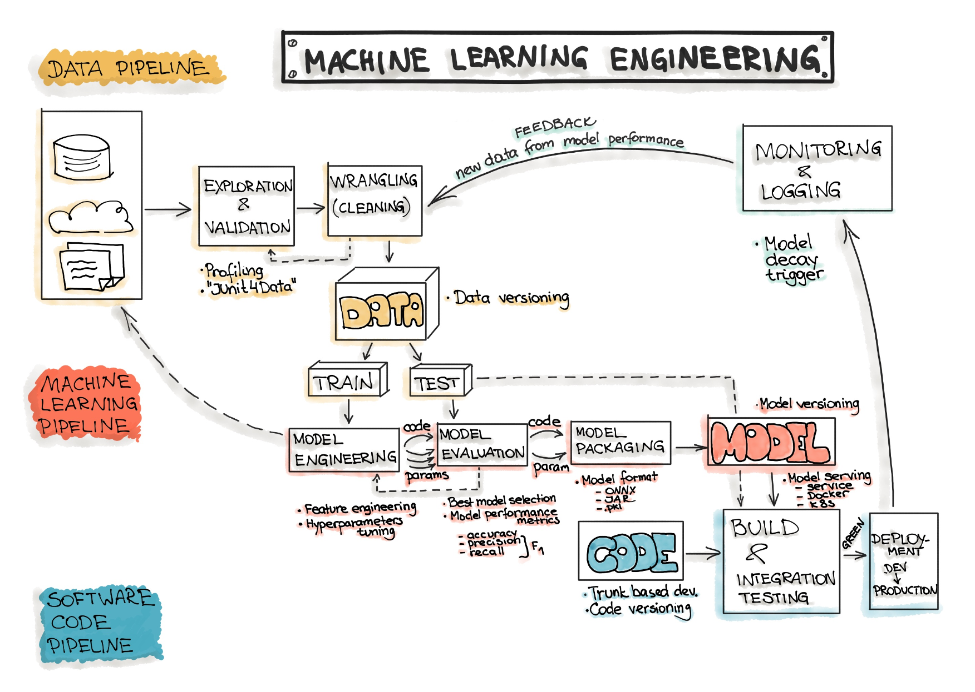
Data, Model, and Code
Generally, the goal of a machine learning project is to build a statistical model by using collected data and applying machine learning algorithms to them.
ML-based software includes three main artifacts: Data, ML Model, and Code.
Accordingly, the typical machine learning workflow consists of three main phases:
Data Engineering: data acquisition & data preparation,
Model Engineering: ML model training & serving, and
Code Engineering: integrating ML model into the final product.

Slide 59
Data Engineering

Slide 60
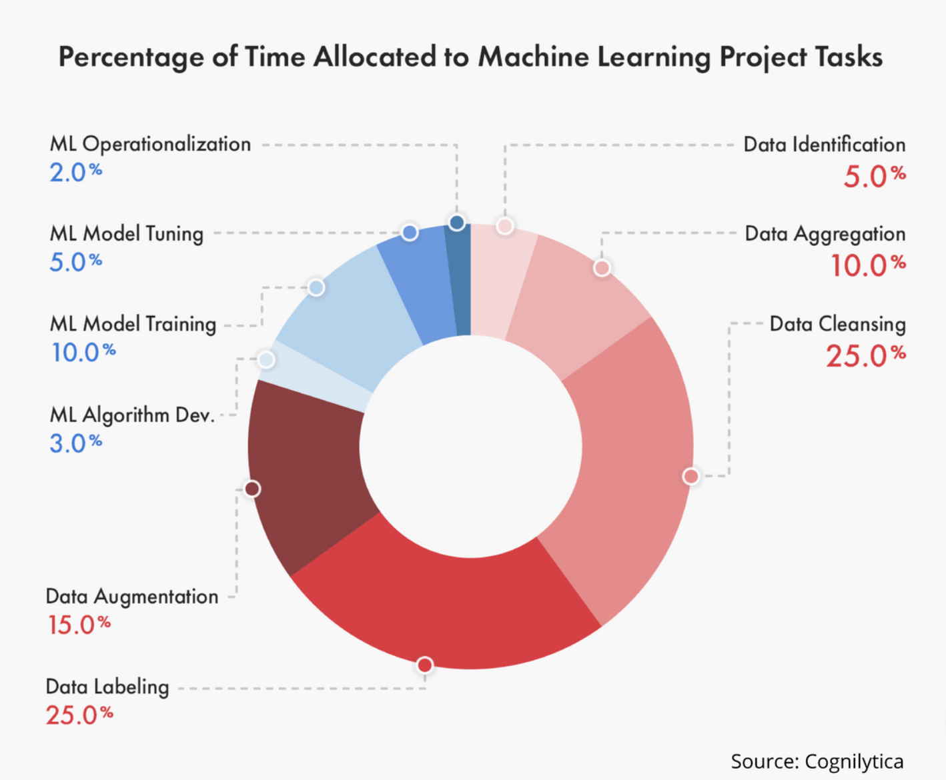
Data Engineering
The Data Engineering pipeline includes a sequence of operations on the available data that leads to supplying training and testing datasets for the machine learning algorithms:
Data Ingestion - Collecting data by using various frameworks and formats, such as Spark, HDFS, CSV, etc. This step might also include synthetic data generation or data enrichment.
Data Versioning - Data versioning is the storage of different versions of data that were created or changed at specific points in times.
Exploration and Validation - Includes data profiling to obtain information about the content and structure of the data. The output of this step is a set of metadata, such as max, min, avg of values. Data validation operations are user-defined error detection functions, which scan the dataset in order to spot some errors.
Data Wrangling (Cleaning) - The process of re-formatting particular attributes and correcting errors in data, such as missing values imputation.
Data Labeling - The operation of the Data Engineering pipeline, where each data point is assigned to a specific category.
Data Splitting - Splitting the data into training, validation, and test datasets to be used during the core machine learning stages to produce the ML model.

Slide 61
Ingestion
Data Ingestion - Collecting data by using various systems, frameworks and formats, such as internal/external databases, data marts, OLAP cubes, data warehouses, OLTP systems, Spark, HDFS etc. This step might also include synthetic data generation or data enrichment.
The amount and quality of the data set are usually problem-specific and can be empirically discovered.
Data Sources, Space Estimation and Space Location
Back up Data: keep the original dataset untouched.
Privacy Compliance: Ensure sensitive information is deleted or protected (e.g., anonymized) to ensure GDPR compliance.
Metadata Catalog: Start documenting the metadata of the dataset by recording the basic information about the size, format, aliases, last modified time, and access control lists.

Slide 62
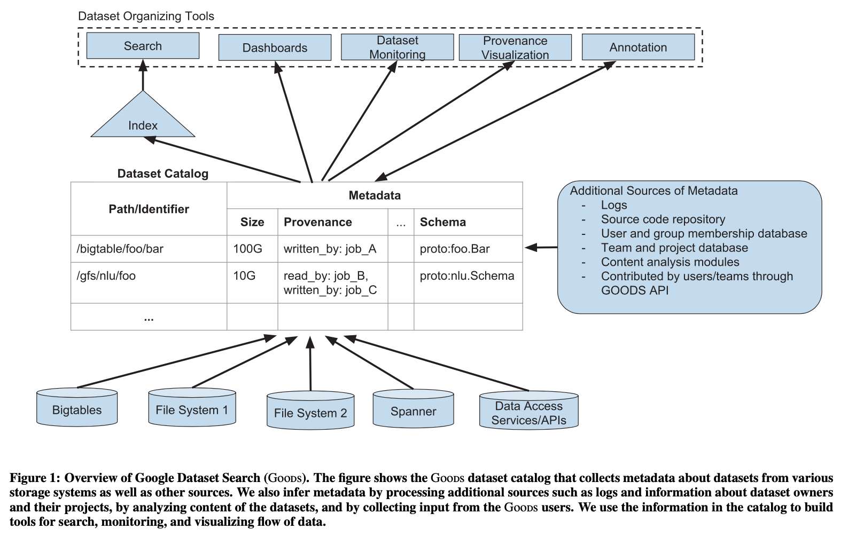
Ingestion
Goods: Organizing Google’s Datasets
Alon Halevy2∗, Flip Korn1, Natalya F. Noy1, Christopher Olston1, Neoklis Polyzotis1, Sudip Roy1, Steven Euijong Whang1

Slide 63
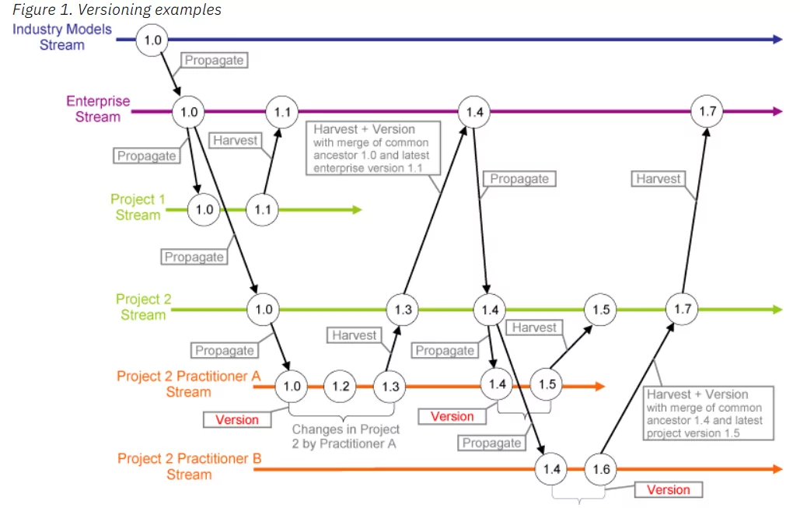
Versioning
Preserving the working version while testing: AI/ML models work with the goal of maximizing business efficiency. It is normal for development teams to test new ways to increase efficiency. Introducing a new dataset into systems could be one of those exercises.
Measuring the business performance: without the intervention of engineers, datasets can change over time. Sales data, for example, is changed by each transaction.
Compliance and auditing benefits: data versioning can help with both internal and external audits and compliance processes by ensuring data is stored from specific times.
Challenges: storage space, security

Slide 64
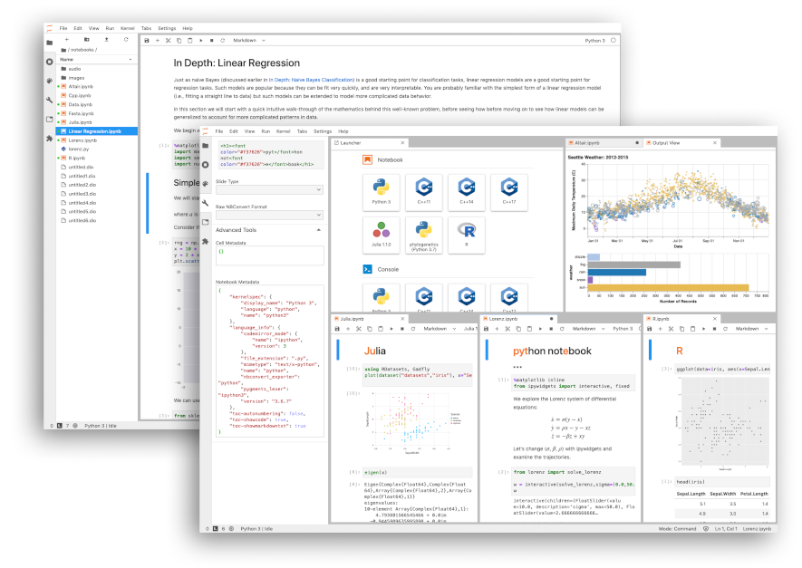
Exploration
Exploration profiles the content and structure of the data. The output of this step is a set of metadata, such as max, min, average of values
Name
Number of Records
Data Type (categorical, numerical, int/float, text, structured, etc.)
Numerical Measures (min, max, average, median, etc. for numerical data)
Amount of missing values (or “missing value ratio” = Number of absent values/ Number of records)
Type of distribution (Gaussian, uniform, logarithmic, etc.)
Data Visualization: build a visual representation for value distribution.
Attributes Correlation: compute and analyze the correlations between attributes
https://www.kaggle.com/datasets/ruchi798/data-science-job-salaries

Slide 65
Validation
Data validation refers to the process of ensuring the accuracy and quality of data. It is implemented by building several checks into a system or report to ensure the logical consistency of input and stored data.
Data Type Check: For example, a field might only accept numeric data. If this is the case, then any data containing other characters such as letters or special symbols should be rejected by the system.
Code Check: For example, it is easier to verify that a postal code is valid by checking it against a list of valid codes.
Range Check: For example, latitude and longitude are commonly used in geographic data. A latitude value should be between -90 and 90, while a longitude value must be between -180 and 180. Any values out of this range are invalid.
Format Check: For example, Many data types follow a certain predefined format. A common use case is date columns that are stored in a fixed format like “YYYY-MM-DD” or “DD-MM-YYYY.”
Consistency Check: For example, checking if the delivery date is after the shipping date for a parcel.
Uniqueness Check: For example, checking that an item is not entered multiple times into a database.
https://www.projectpro.io/recipes/perform-data-validation-python-by-processing-only-matched-columns

Slide 66
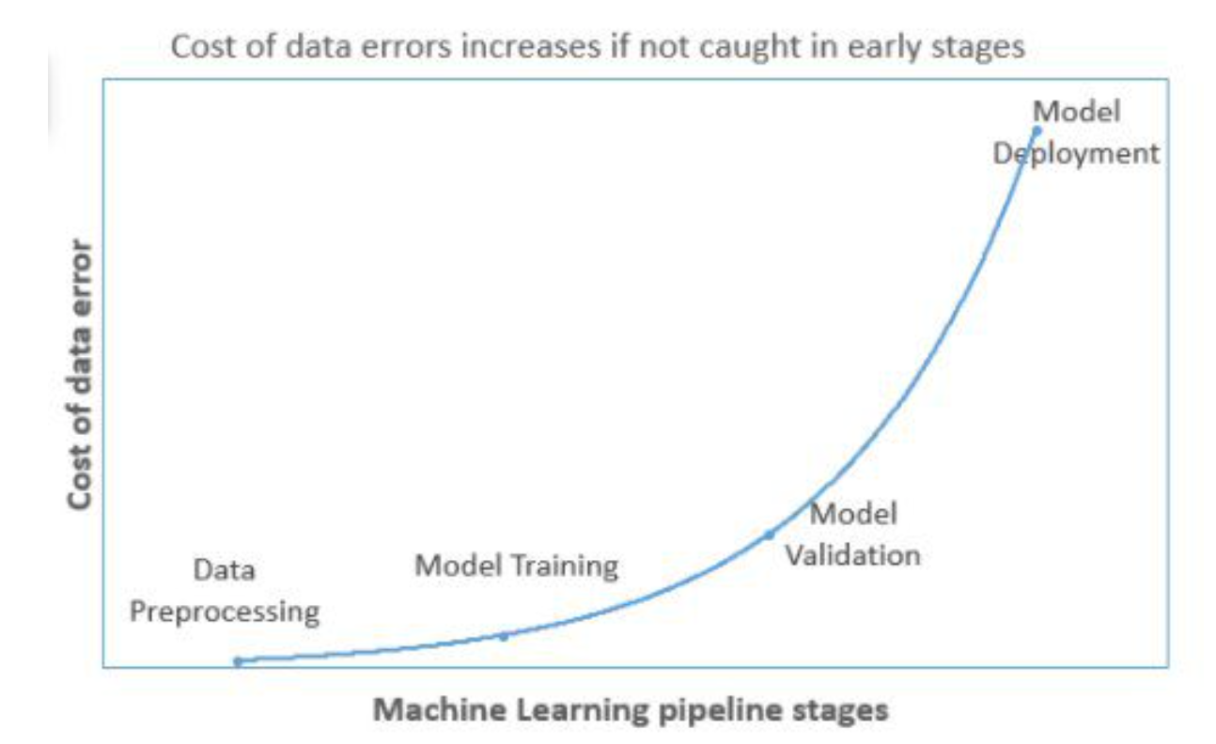
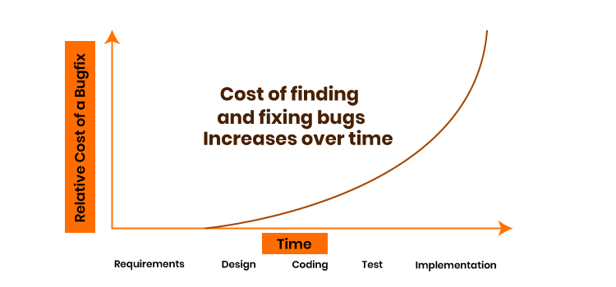
Validation (Statistical)
garbage in garbage out
Models get re-trained with incremental data. The model makes predictions with new incoming data and the same data is added with actual labels and used for retraining.
Since In each iteration, newly added data is generally a small fraction of overall training data, hence, the changes in model accuracy will be easily missed and the errors will keep adding with time. ​​​​​​​ ​​​​​​​​​​​​​​
https://www.kdnuggets.com/2021/05/data-validation-machine-learning-imperative.html

Slide 67
Wrangling
Wrangling includes the following operations (from the book “Principles of Data Wrangling”)
Reordering record fields by moving columns
Creating new record fields through extracting values
Combining multiple record fields into a single record field
Filtering datasets by removing sets of records
Shifting the granularity of the dataset and the fields associated with records through aggregations and pivots.
Fixing or removing outliers
Dealing with missing values (NaN can be replaced with mean, mode, the most frequent value of the column or simply by dropping the row).
Reshaping data according to the requirements, where new data can be added or pre-existing data can be modified.
https://www.geeksforgeeks.org/data-wrangling-in-python/

Slide 68
Labelling
Data labeling is the process of identifying raw data (images, text files, videos, etc.) and adding one or more meaningful and informative labels to provide context so that a machine learning model can learn from it.
Accuracy in data labeling measures how close the labeling is to ground truth, or how well the labeled features in the data are consistent with real-world conditions.
Quality in data labeling is about accuracy across the overall dataset. Does the work of all of your labelers look the same? Is labeling consistently accurate across your datasets?
Data labeling includes a wide array of tasks:
Using a tool to enrich data
Quality assurance for data labeling
Process iteration, such as changes in data feature selection, task progression, or QA
Management of data labelers
Training of new team members
Project planning, process operationalization, and measurement of success

Slide 69
Labelling (HITL)
Organizations use a combination of software, processes, and people to clean, structure, or label data. In general, you have four options for your data labeling workforce:
Employees - They are on your payroll, either full-time or part-time. Their job description may not include data labeling.
Managed teams - You use vetted, trained, and actively managed data labelers (e.g., CloudFactory).
Contractors - They are temporary or freelance workers.
Crowdsourcing - You use a third-party platform to access large numbers of workers at once.
How is quality measured in data labeling?
Gold standard - There’s a correct answer for the task. Measure quality based on correct and incorrect tasks.
Sample review - Select a random sample of completed tasks. A more experienced worker, such as a team lead or project manager, reviews the sample for accuracy.
Consensus - Assign several people do the same task, and the correct answer is the one that comes back from the majority of labelers.
Intersection over union (IoU) - This is a consensus model often used in object detection within images. It combines people and automation to compare the bounding boxes of your hand-labeled, ground truth images with the predicted bounding boxes from your model.

Slide 70
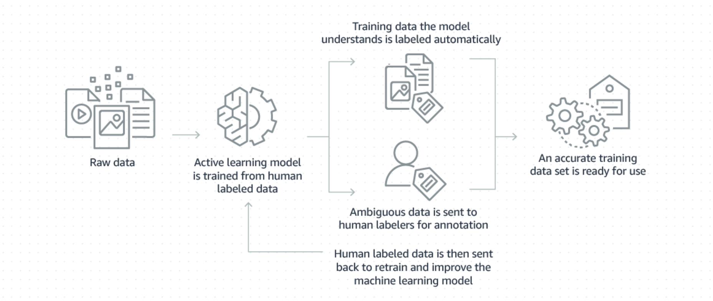
Labelling (AUTO)

Slide 71
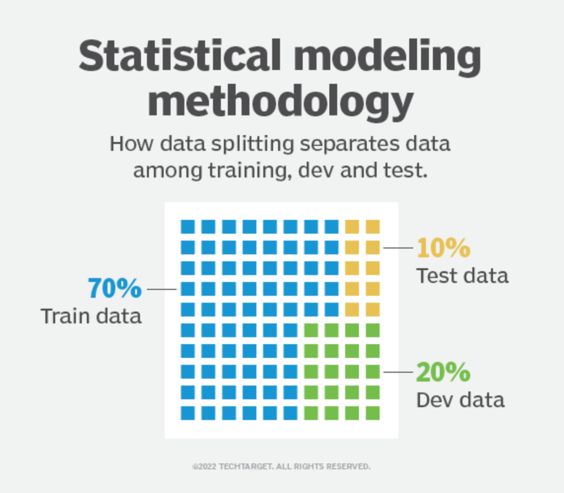
Splitting
The original data in a machine learning model is typically taken and split into three sets:
The training set is the portion of data used to train the model. The model should observe and learn from the training set, optimizing any of its parameters.
The dev set is a data set of examples used to change learning process parameters (cross-validation). This set of data has the goal of ranking the model's accuracy and can help with model selection.
The testing set is the portion of data that is tested in the final model and is compared against the previous sets of data. The testing set acts as an evaluation of the final mode and algorithm.

Slide 72
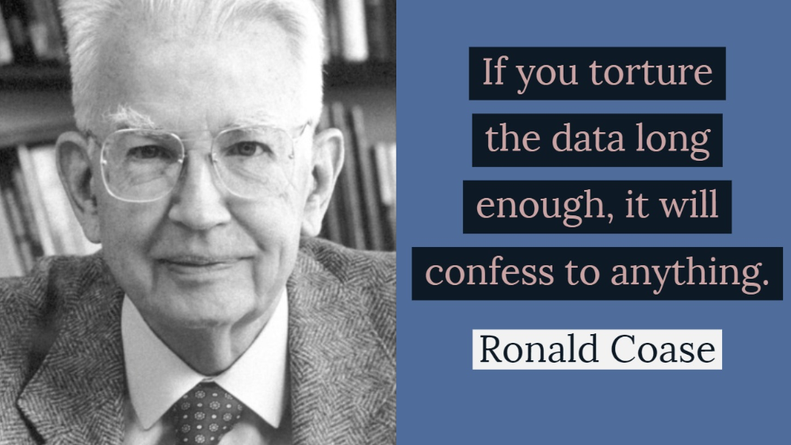
Splitting and “data snooping”
Sample a test set, put it aside, and never look at it to avoid the “data snooping” bias. You fell for this if you are selecting a particular kind of ML model by using the test set.
This will lead to an ML model selection that is too optimistic and will not perform well in production (overfitting).
https://datascience.stanford.edu/news/data-snooping

Slide 73
Model Engineering

Slide 74
Model Engineering
The core of the ML workflow is the phase of writing and executing machine learning algorithms to obtain an ML model. The Model Engineering pipeline includes a number of operations that lead to a final model:
Model Training - The process of applying the machine learning algorithm on training data to train an ML model. It also includes feature engineering and the hyperparameter tuning for the model training activity.
Model Evaluation - Validating the trained model to ensure it meets original codified objectives before serving the ML model in production to the end-user.
Model Testing - Performing the final “Model Acceptance Test” by using the hold backtest dataset.
Model Packaging - The process of exporting the final ML model into a specific format (e.g. PMML, PFA, or ONNX), which describes the model, in order to be consumed by the business application.

Slide 75
Model Training
Every ML model specification (code that creates an ML model) should go through a code review and be versioned.
Train many ML models from different categories (e.g., linear regression, logistic regression, k-means, naive Bayes, SVM, Random Forest, etc.) using standard parameters.
Measure and compare their performance. For each model, use N-fold cross-validation and compute the mean and standard deviation of the performance measure on the N folds.
Error Analysis: analyze the types of errors the ML models make.
Hyperparameters tuning by using cross-validation. Please note that data transformation choices are also hyperparameters. Random search for hyperparameters is preferred over grid search.
Consider Ensemble methods such as majority vote, bagging, boosting, or stacking. Combining ML models should produce better performance than running them individually. (Further reading “Ensemble Methods: Foundations and Algorithms” by Zhi-Hua Zhou)

Slide 76
Model Training (Features Engineering)
Discretize continuous features
Decompose features (e.g., categorical, date/time, etc.)
Add transformations of features (e.g., log(x), sqrt(x), x2, etc.)
Aggregate features into promising new features
Feature scaling: Standardize or normalize features
New features should be added quickly to get fast to production
Further reading
“Feature Engineering for Machine Learning. Principles and Techniques for Data Scientists” by Alice Zheng, Amanda Casari
“Hands-On Machine Learning with Scikit-Learn, Keras, and TensorFlow” by Aurélien Géron

Slide 77
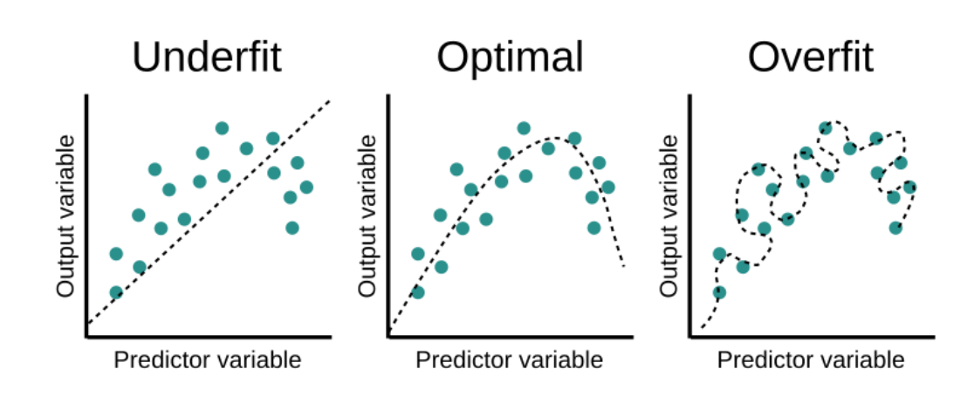
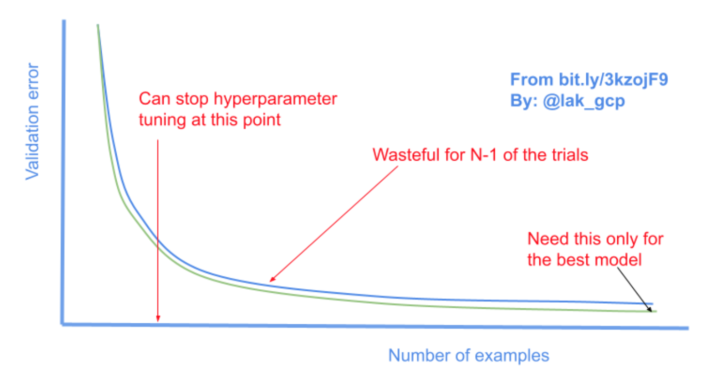
Model Training (hyperparameter tuning)
Model parameters are the properties of the training data that are learned by the ML model during training. So, parameters are internal to the model. For instance, the coefficients in regression or the weights and biases in a neural network are model parameters since they are estimated through the training process.
Model hyperparameters are configurations of the model that are set before and determine the training process. Hyperparameters are external to the model. The “hyper-” prefix implies that they are higher-level parameters that control the learning process. Some examples of hyperparameters include:
Number of hidden layers in a neural network
Number of leaves of a decision tree
Learning rate of a gradient descent
The ratio between the training set and test set

Slide 78
Model Training (hyperparameter tuning)
There are three main methods to find the optimal set of values for hyperparameters:
Grid search is determining a set of values for each hyperparameter, running the model with each possible combination of these values, and picking the set of values that produce the best results. Grid search involves guesswork since the values to be tried are set manually by the practitioner.
Random search involves picking random combinations of hyperparameter values from given statistical distributions to find an optimal set of values. The advantage of random search over grid search is that it allows searching in a wider range of values without increasing the number of trials.
Bayesian search is a sequential method that uses the results of the previous sets of hyperparameters to improve the next search process. Bayesian search reduces the optimization time especially for models trained on a large amount of data.
https://github.com/optuna/optuna
https://github.com/google/vizier
https://github.com/autonomio/talos
http://hyperopt.github.io/hyperopt/
https://scikit-optimize.github.io/stable/

Slide 79
Model Evaluation
Model Evaluation - Validate the trained model to ensure it meets original business objectives before serving the ML model in production to the end-user.

Slide 80
Model Testing
Model Testing - Once the final ML model is trained, its performance needs to be measured by using the hold-back test dataset to estimate the generalization error by performing the final “Model Acceptance Test”.

Slide 81
Model Packaging
Model Packaging - The process of exporting the final ML model into a specific format (e.g. PMML, PFA, or ONNX), which describes the model to be consumed by the business application. We cover the ML model packaging in the part ‘ML Model serialization formats’ below.

Slide 82
Different forms of ML workflows
Operating an ML model might assume several architectural styles. In the following, we discuss four architectural patterns which are classified along two dimensions:
ML Model Training
ML Model Prediction

Slide 83
Different forms of ML workflows
There are two ways how we perform ML Model Training:
Offline learning (aka batch or static learning): The model is trained on a set of already collected data. After deploying to the production environment, the ML model remains constant until it re-trained because the model will see a lot of real-live data and becomes stale. This phenomenon is called ‘model decay’ and should be carefully monitored.
Online learning (aka dynamic learning): The model is regularly being re-trained as new data arrives, e.g. as data streams. This is usually the case for ML systems that use time-series data, such as sensor, or stock trading data to accommodate the temporal effects in the ML model.

Slide 84
Different forms of ML workflows
The second dimension is ML Model Prediction, which denotes the mechanics of the ML model to make predictions. Here we also distinguish two modes:
Batch predictions: The deployed ML model makes a set of predictions based on historical input data. This is often sufficient for data that is not time-dependent, or when it is not critical to obtain real-time predictions as output.
Real-time predictions (aka on-demand predictions): Predictions are generated in real-time using the input data that is available at the time of the request.

Slide 85
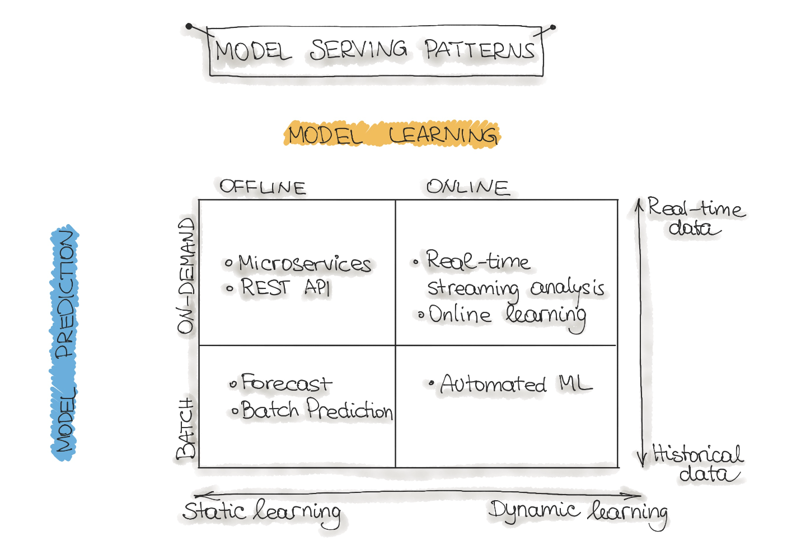
Model Serving Patterns

Slide 86
Model Serving Patterns -Forecast
This type of machine learning workflow is widely spread in academic research or data science education (e.g., Kaggle or DataCamp). This form is used to experiment with ML algorithms and data as it is the easiest way to create a machine learning system.
Usually, we take an available dataset, train the ML model, then run this model on another (mostly historical) data, and the ML model makes predictions. This way, we output a forecast. This ML workflow is not very useful and, therefore, not common in an industry setting for production systems (e.g. mobile applications).

Slide 87
Model Serving Patterns – Web Service
The most commonly described deployment architecture for ML models is a web service (microservice). The web service takes input data and outputs a prediction for the input data points. The model is trained offline on historical data, but it uses real-live data to make predictions.
The difference from a forecast (batch predictions) is that the ML model runs near real-time and handles a single record at a time instead of processing all the data at once. The web service uses real-time data to make predictions, but the model remains constant until it is re-trained and re-deployed into the production system.

Slide 88
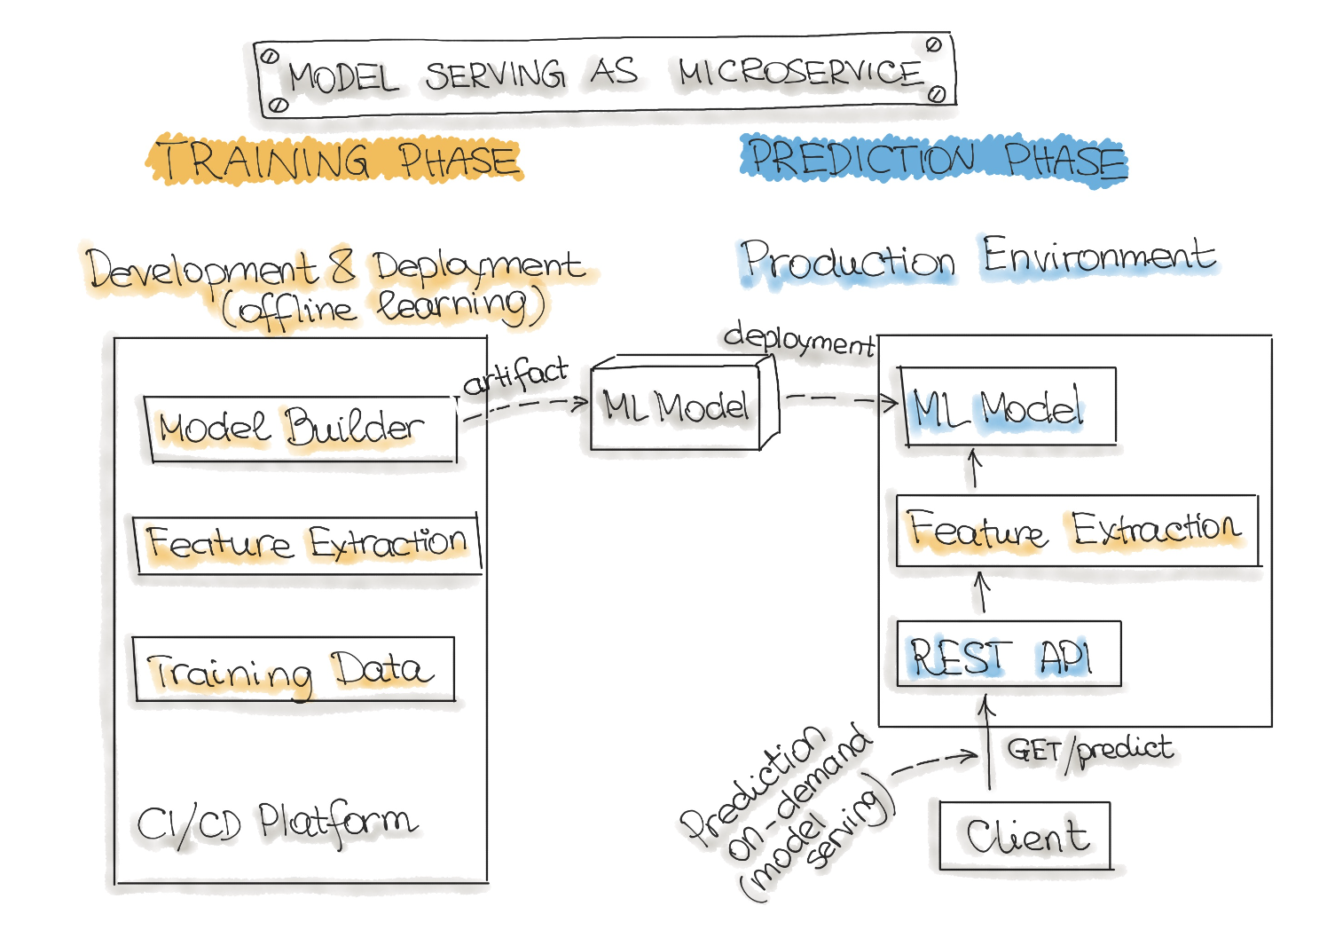
Model Serving Patterns – Web Service

Slide 89
Model Serving Patterns – Online learning
The most dynamic way to embed machine learning into a production system is to implement online learning, which is also known as real-time streaming analytics. Please note that online learning can be a confusing name because the core learning or ML model training is usually not performed on the live system. We should call it incremental learning; however, the term online learning is already established within the ML community.
In this type of ML workflow, the ML learning algorithm is continuously receiving a data stream, either as single data points or in small groups called mini-batches. The system learns about new data on the fly as it arrives, so the ML model is incrementally being re-trained with new data. This continually re-trained model is instantly available as a web service.
Technically, this type of ML system works well with the lambda architecture in big data systems. Usually, the input data is a stream of events, and the ML model takes the data as it enters the system, provides predictions and re-learns on these new data. The model would typically run as a service on a Kubernetes cluster or similar.
A big difficulty with the online learning system in production is that if bad data is entering the system, the ML model, as well as the whole system performance, will increasingly decline.

Slide 90
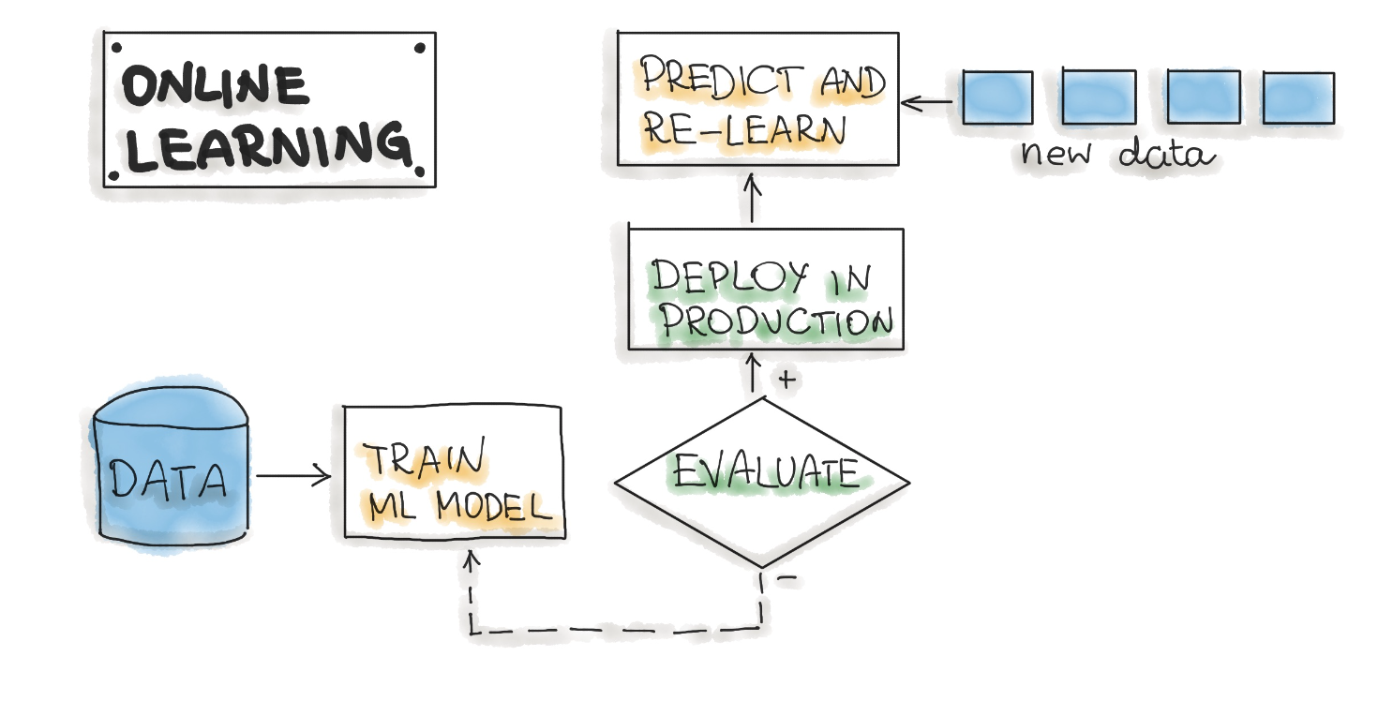
Model Serving Patterns – Online learning

Slide 91
Model Serving Patterns – AutoML
An even more sophisticated version of online learning is automated machine learning or AutoML.
AutoML is getting a lot of attention and is considered the next advance for enterprise ML. AutoML promises training ML models with minimal effort and without machine learning expertise. The user needs to provide data, and the AutoML system automatically selects an ML algorithm, such as neural network architecture, and configures the selected algorithm.
Instead of updating the model, we execute an entire ML model training pipeline in production that results in new models on the fly. For now, this is a very experimental way to implement ML workflows. AutoML is usually provided by big cloud providers, such as Google or MS Azure. However, models build with AutoML need to reach the level of accuracy required for real-world success.

Slide 92
ML Model serialization formats
There are various formats to distribute ML models. In order to achieve a distributable format, the ML model should be present and should be executable as an independent asset. For example, we might want to use a Scikit-learn model in a Spark job. This means that the ML models should work outside of the model-training environment. In the following, we describe Language-agnostic and Vendor-specific exchange formats for ML models.

Slide 93
ML Model serialization formats
There are various formats to distribute ML models. In order to achieve a distributable format, the ML model should be present and should be executable as an independent asset. For example, we might want to use a Scikit-learn model in a Spark job. This means that the ML models should work outside of the model-training environment. In the following, we describe Language-agnostic and Vendor-specific exchange formats for ML models.

Slide 94
Language-agnostic exchange formats

Slide 95
ML Model serialization formats
Amalgamation is the simplest way to export an ML model. The model and all necessary code to run are bundled as one package. Usually, it is a single source code file that can be compiled on nearly any platform as a standalone program. For example, we can create a standalone version of an ML model by using SKompiler. This python package provides a tool for transforming trained Scikit-learn models into other forms, such as SQL queries, Excel formulas, Portable Format for Analytics (PFA) files, or SymPy expressions. The last can be translated to code in a variety of languages, such as C, Javascript, Rust, Julia, etc. Amalgamation is a straightforward concept, and the exported ML models are portable. With some easy ML algorithms, such as logistic regression or decision tree, this format is compact and might have good performance, which is useful for constrained embedded environments. However, the ML model code and parameters need to be managed together.

Slide 96
PMML
PMML is a format for model serving based on XML with the file extension .pmml. PMML has been standardized by the Data Mining Group (DMG). Basically, .ppml describes a model and pipeline in XML. The PMML supports not all of the ML algorithms, and its usage in open source-driven tools is limited due to licensing issues.

Slide 97
PFA
PFA (Portable Format for Analytics) is designed as a replacement for PMML. From DMG: “A PFA document is a string of JSON-formatted text that describes an executable called a scoring engine. Each engine has a well-defined input, a well-defined output, and functions for combining inputs to construct the output in an expression-centric syntax tree”. PFA capabilities include (1) control structures, such as conditionals, loops, and user-defined functions, (2) expressed within JSON, and can, therefore, be easily generated and manipulated by other programs, (3) fine-grained function library supporting extensibility callbacks. To run ML models as PFA files, we will need a PFA-enabled environment.

Slide 98
ONNX
ONNX (Open Neural Network eXchange) is an ML framework independent file format. ONNX was created to allow any ML tool to share a single model format. This format is supported by many big tech companies such as Microsoft, Facebook, and Amazon. Once the ML model is serialized in the ONNX format, it can be consumed by onnx-enabled runtime libraries (also called inference engines) and then make predictions. Here you will find the list of tools that can use ONNX format. Notably that most deep learning tools have ONNX support.

Slide 99
Vendor-specific exchange formats
Scikit-Learn saves models as pickled python objects, with a .pkl file extension.
H2O allows you to convert the models you have built to either POJO (Plain Old Java Object) or MOJO (Model Object, Optimized).
SparkML models that can be saved in the MLeap file format and served in real-time using an MLeap model server. The MLeap runtime is a JAR that can run in any Java application.MLeap supports Spark, Scikit-learn, and Tensorflow for training pipelines and exporting them to an MLeap Bundle.
TensorFlow saves models as .pb files; which is the protocol buffer files extension.
PyTorch serves models by using their proprietary Torch Script as a .pt file. Their model format can be served from a C– application.
Keras saves a model as a .h5 file, which is known in the scientific community as a data file saved in the Hierarchical Data Format (HDF). This type of file contains multidimensional arrays of data.
Apple has its proprietary file format with the extension .mlmodel to store models embedded in iOS applications. The Core ML framework has native support for Objective-C and Swift programming languages. Applications trained in other ML frameworks, such as TensorFlow, Scikit-Learn, and other frameworks need to use tools like such as coremltools and Tensorflow converter to translate their ML model files to the .mlmodel format for use on iOS.

Slide 100
Code Engineering

Slide 101
Code Engineering
Once we trained a machine learning model, we need to deploy it as part of a business application such as a mobile or desktop application. The ML models require various data points (feature vector) to produce predictions. The final stage of the ML workflow is the integration of the previously engineered ML model into existing software. This stage includes the following operations:
Model Serving - The process of addressing the ML model artifact in a production environment.
Model Performance Monitoring - The process of observing the ML model performance based on live and previously unseen data, such as prediction or recommendation. In particular, we are interested in ML-specific signals, such as prediction deviation from previous model performance. These signals might be used as triggers for model re-training.
Model Performance Logging - Every inference request results in the log-record.

Slide 102
Code: Deployment Pipelines
The final stage of delivering an ML project includes the following three steps:
Model Serving - The process of deploying the ML model in a production environment.
Model Performance Monitoring - The process of observing the ML model performance based on live and previously unseen data, such as prediction or recommendation. In particular, we are interested in ML-specific signals, such as prediction deviation from previous model performance. These signals might be used as triggers for model re-training.
Model Performance Logging - Every inference request results in a log-record.
In the following, we discuss Model Serving Patterns and Model Deployment Strategies.

Slide 103
Code: Deployment Pipelines
The final stage of delivering an ML project includes the following three steps:
Model Serving - The process of deploying the ML model in a production environment.
Model Performance Monitoring - The process of observing the ML model performance based on live and previously unseen data, such as prediction or recommendation. In particular, we are interested in ML-specific signals, such as prediction deviation from previous model performance. These signals might be used as triggers for model re-training.
Model Performance Logging - Every inference request results in a log-record.
In the following, we discuss Model Serving Patterns and Model Deployment Strategies.

Slide 104
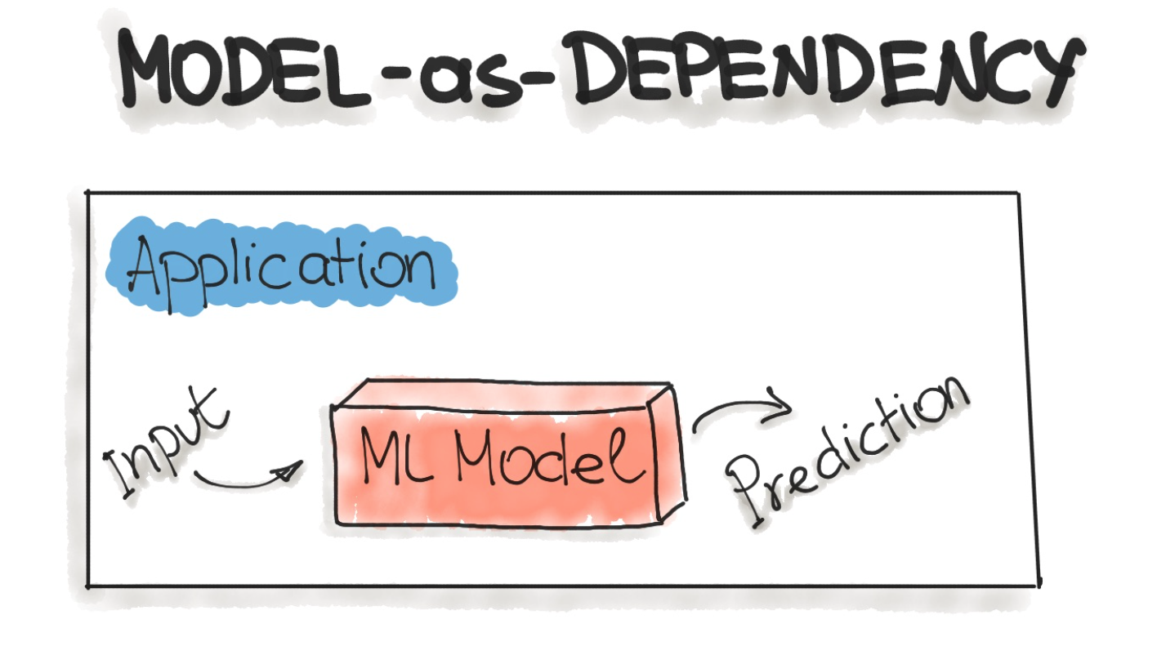
Model-as-Dependency
A packaged ML model is considered as a dependency within the software application.
For example, the application consumes the ML model like a conventional jar dependency by invoking the prediction method and passing the values. The return value of such method execution is some prediction that is performed by the previously trained ML model.
The Model-as-Dependency approach is mostly used for implementing the Forecast pattern.

Slide 105
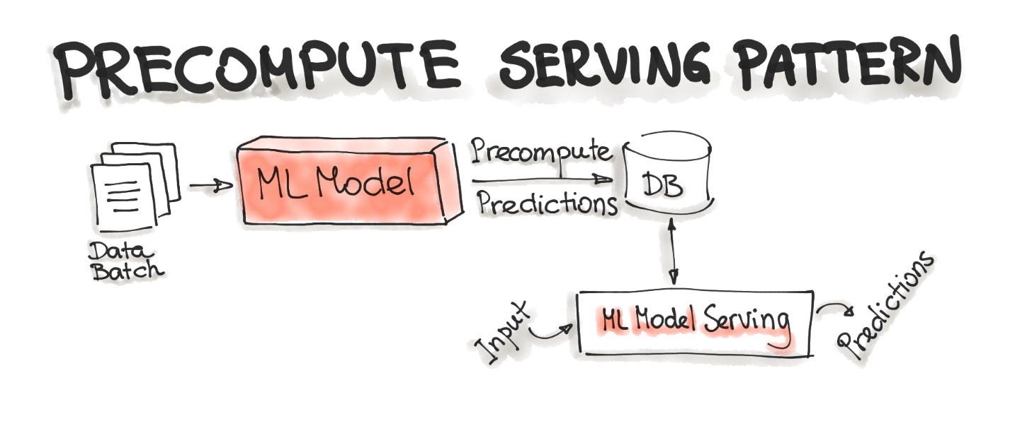
Precompute Serving Pattern
With the Precompute serving pattern, we use an already trained ML model and precompute the predictions for the incoming batch of data. The resulting predictions are persisted in the database. Therefore, for any input request, we query the database to get the prediction result.
This type of ML model serving is tightly related to the Forecast ML workflow.

Slide 106
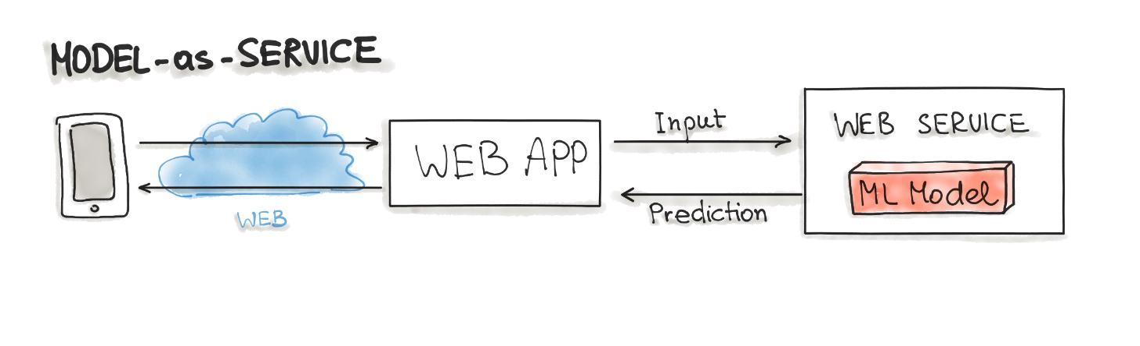
Model-as-Service
Model-as-Service is a common pattern for wrapping an ML model as an independent service. We can wrap the ML model and the interpreter within a dedicated web service that applications can request through a REST API or consume as a gRPC service.
This pattern can be used for various ML workflows, such as Forecast, Web Service, Online Learning.

Slide 107
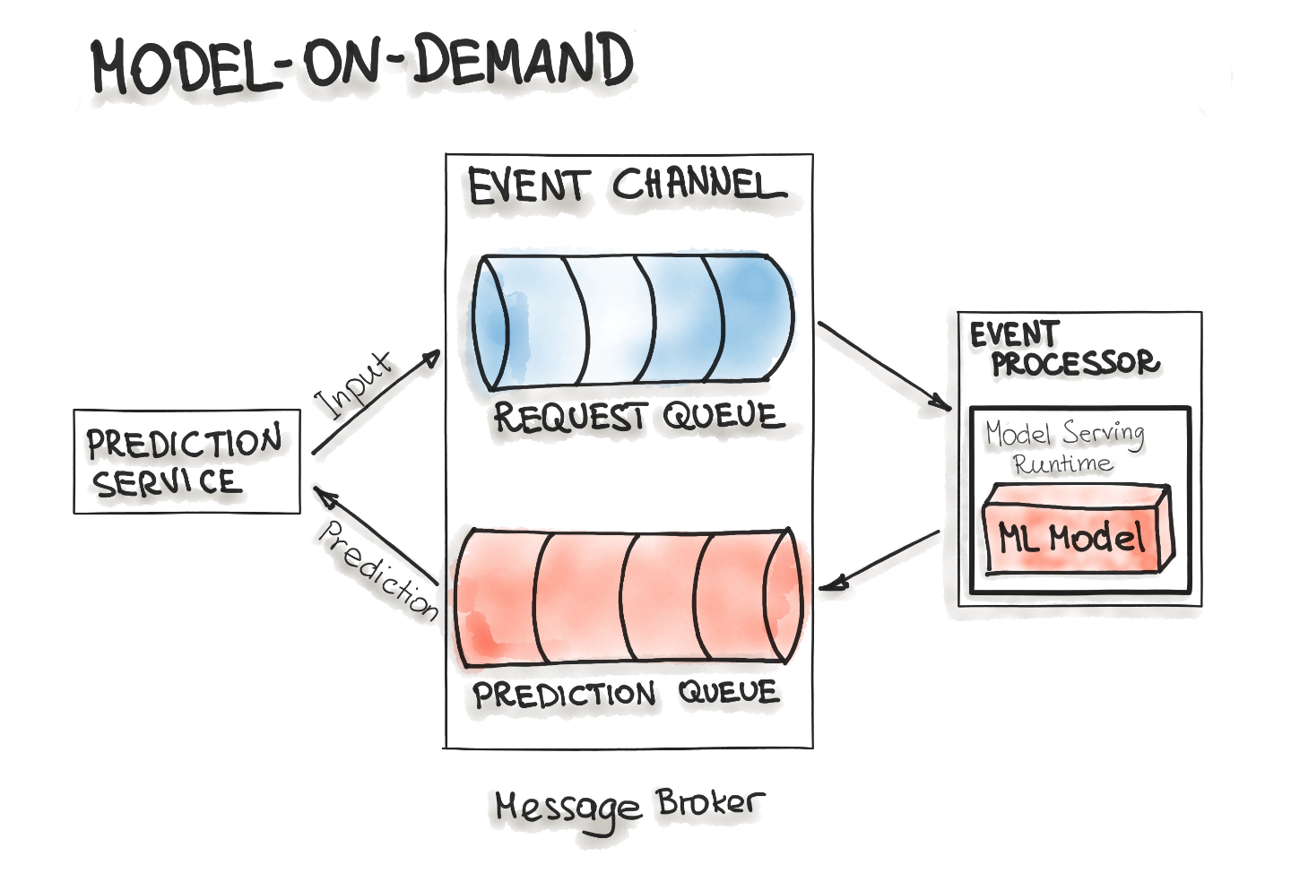
Model-on-demand
The Model-on-Demand pattern also treats the ML model as a dependency that is available at runtime. This ML model, contrary to the Model-as-Dependency pattern, has its own release cycle and is published independently.
The event processor contains the model serving runtime and the ML model. This process connects to the broker, reads these requests in batch from the queue and sends them to the model to make the predictions. The model serving process runs the prediction generation on the input data and writes the resulted predictions to the output queue. Afterwards, the queued prediction results are pushed to the prediction service that initiated the prediction request.

Slide 108
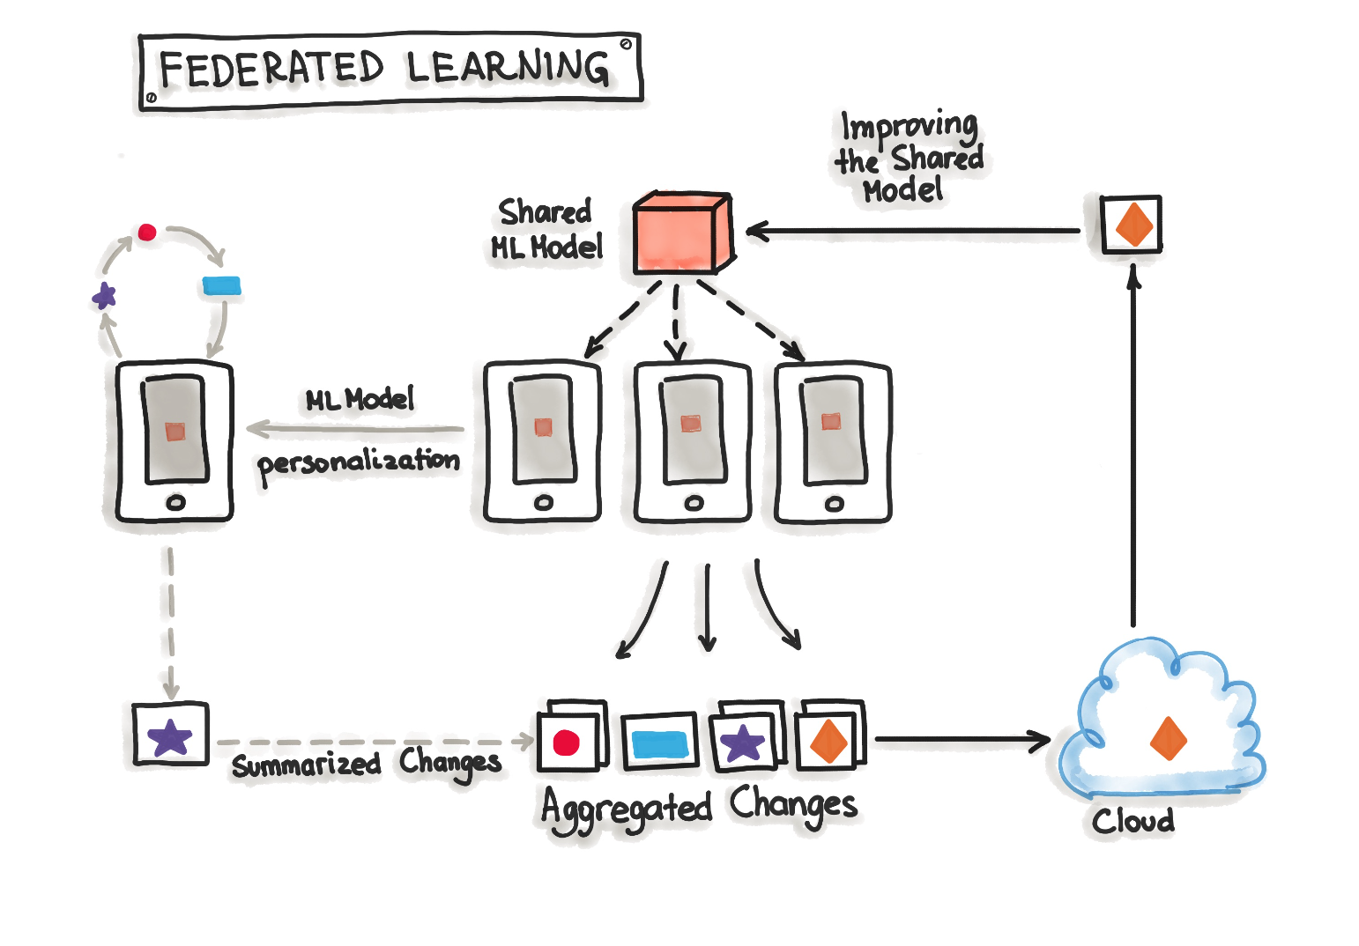
Hybrid-Serving (Federated Learning)
The big benefit of this is that the data used for training and testing, which is highly personal, never leaves the devices while still capturing all data that is available. This way it is possible to train highly accurate models while not having to store tons of (probably personal) data in the cloud. But there is no such thing as a free lunch, normal machine learning algorithms are built with homogeneously and large datasets on powerful hardware which is always available for training. With Federated Learning there are other circumstances, the mobile devices are less powerful, the training data is distributed across millions of devices and these are not always available for training. Exactly for this TensorFlow Federated (TFF) has been created. TFF is a lightweight form of TensorFlow created for Federated Learning.

Slide 109
Keep an eye on model drift
• Online measurement of accuracy: Just as you need to know the latency of your website and public application programming interfaces, you need to know how accurate your models are in production. How many predictions actually came true? This requires collecting and logging real-use results but is an elementary requirement.
• Mind the gap: That is, watch out for gaps between the distributions of your training and online data sets. This is a simple-to-measure, effective-in-practice heuristic that uncovers a variety of issues. If your training data has 50% high-risk patients, but in production, you're predicting only 30% as high-risk, it's probably time to retrain.
• Online data quality alerts: If the number or ratio of the input data changes in an unexpected way, an alert should go to your operations team. Are you patients suddenly older, more female or less diabetic? If you haven't trained your model on those types of patients, you may be serving bad predictions.

Slide 110
Service Mesh

Slide 111
Service meshes?!!?
Direct connections vs service mesh
Apache Kafka, Kubernetes, Envoy, Istio, Linkerd

Slide 112
Kubeflow (Pipelines/Versioning)

Slide 113
Machine Learning Model Serving Overview (Seldon Core, KFServing, BentoML, MLFlow)
https://medium.com/everything-full-stack/machine-learning-model-serving-overview-c01a6aa3e823#:~:text=A%20notable%20difference%20between%20the,ROUTERS%2C%20COMBINER%2C%20and%20TRANSFORMERS.
Triton

Slide 114
MLOps level 0-1-2

Slide 115
MLOps level 0-1-2
https://neptune.ai/blog/mlops

Slide 116
Best practices for Machine Learning

Slide 117
https://se-ml.github.io/practices/

Slide 118
References

Slide 119
WWW
https://ml-ops.org/
https://se-ml.github.io/
https://neptune.ai/blog/mlops
https://github.com/EthicalML/awesome-production-machine-learning

Slide 120
WWW
https://neptune.ai/blog/mlops-10-best-practices
https://neptune.ai/blog/ml-model-registry
https://neptune.ai/blog/packaging-ml-models
https://neptune.ai/blog/best-open-source-mlops-tools
https://censius.ai/blogs/dvc-vs-mlflow
https://huyenchip.com/mlops/
https://ml-architects.ch/blog_posts/observability_mlops.html
https://madewithml.com/courses/mlops/labeling/
https://www.forbes.com/sites/forbestechcouncil/2019/04/03/why-machine-learning-models-crash-and-burn-in-production/?sh=4994b9202f43

Slide 121
YouTube
https://www.youtube.com/playlist?list=PLIivdWyY5sqLS4lN75RPDEyBgTro_YX7x (Kubeflow)
https://www.youtube.com/watch?v=Us_C4RFOUrA&t=17s Microservice Architectures with Apache Kafka, Kubernetes and Service Mesh (Envoy, Istio, Linkerd)
https://www.youtube.com/playlist?list=PL7WG7YrwYcnDBDuCkFbcyjnZQrdskFsBz (MLOps Tutorials)
https://www.youtube.com/watch?v=Iexch-lTD-I (From data to AI with the Machine Learning Canvas - Louis Dorard (PAPIs))

Slide 122
Tools (Data Management)
Versioning
https://dvc.org/
https://lakefs.io/
https://github.com/dolthub/dolt
https://qri.io/
Validation
https://github.com/Pylons/colander
https://github.com/pyeve/cerberus
https://github.com/schematics/schematics
Wrangling
https://pandas.pydata.org/
Labelling
https://github.com/nlplab/brat
https://github.com/heartexlabs/labelImg
https://github.com/midas-research/audino
https://github.com/mdhmz1/Auto-Annotate
https://labelstud.io/

Slide 123
Tools (Modeling)
Experiment Tracking
https://github.com/guildai/guildai
https://github.com/VertaAI/modeldb
https://github.com/tensorflow/tensorboard
Feature Engineering
https://github.com/cod3licious/autofeat
https://github.com/feast-dev/feast
https://github.com/alteryx/featuretools
https://github.com/blue-yonder/tsfresh
Hyperparameter Optimization
https://github.com/optuna/optuna
https://github.com/google/vizier
https://github.com/autonomio/talos
http://hyperopt.github.io/hyperopt/
https://scikit-optimize.github.io/stable/

Slide 124
Tools (Operationalization)
Model Deployment / Serving
https://github.com/bentoml/BentoML
https://github.com/kubeflow/kubeflow
https://github.com/SeldonIO/seldon-core
https://github.com/tensorflow/serving
Model Monitoring
https://github.com/evidentlyai/evidently
https://github.com/prometheus/prometheus
https://github.com/grafana/grafana
https://github.com/apache/kafka

Slide 125
Tools (MLOps Platforms)
Alibaba Cloud ML Platform for AI
Amazon SageMaker
Google Cloud Platform
Microsoft Azure
https://mlflow.org/
https://zenml.io/home
https://www.openml.org/

